Slide 1


Lecturer: Alireza Alivand
Faculty of Electrical and Computer Engineering, Urmia University
Electronic orientation internship
Article 9

Slide 2
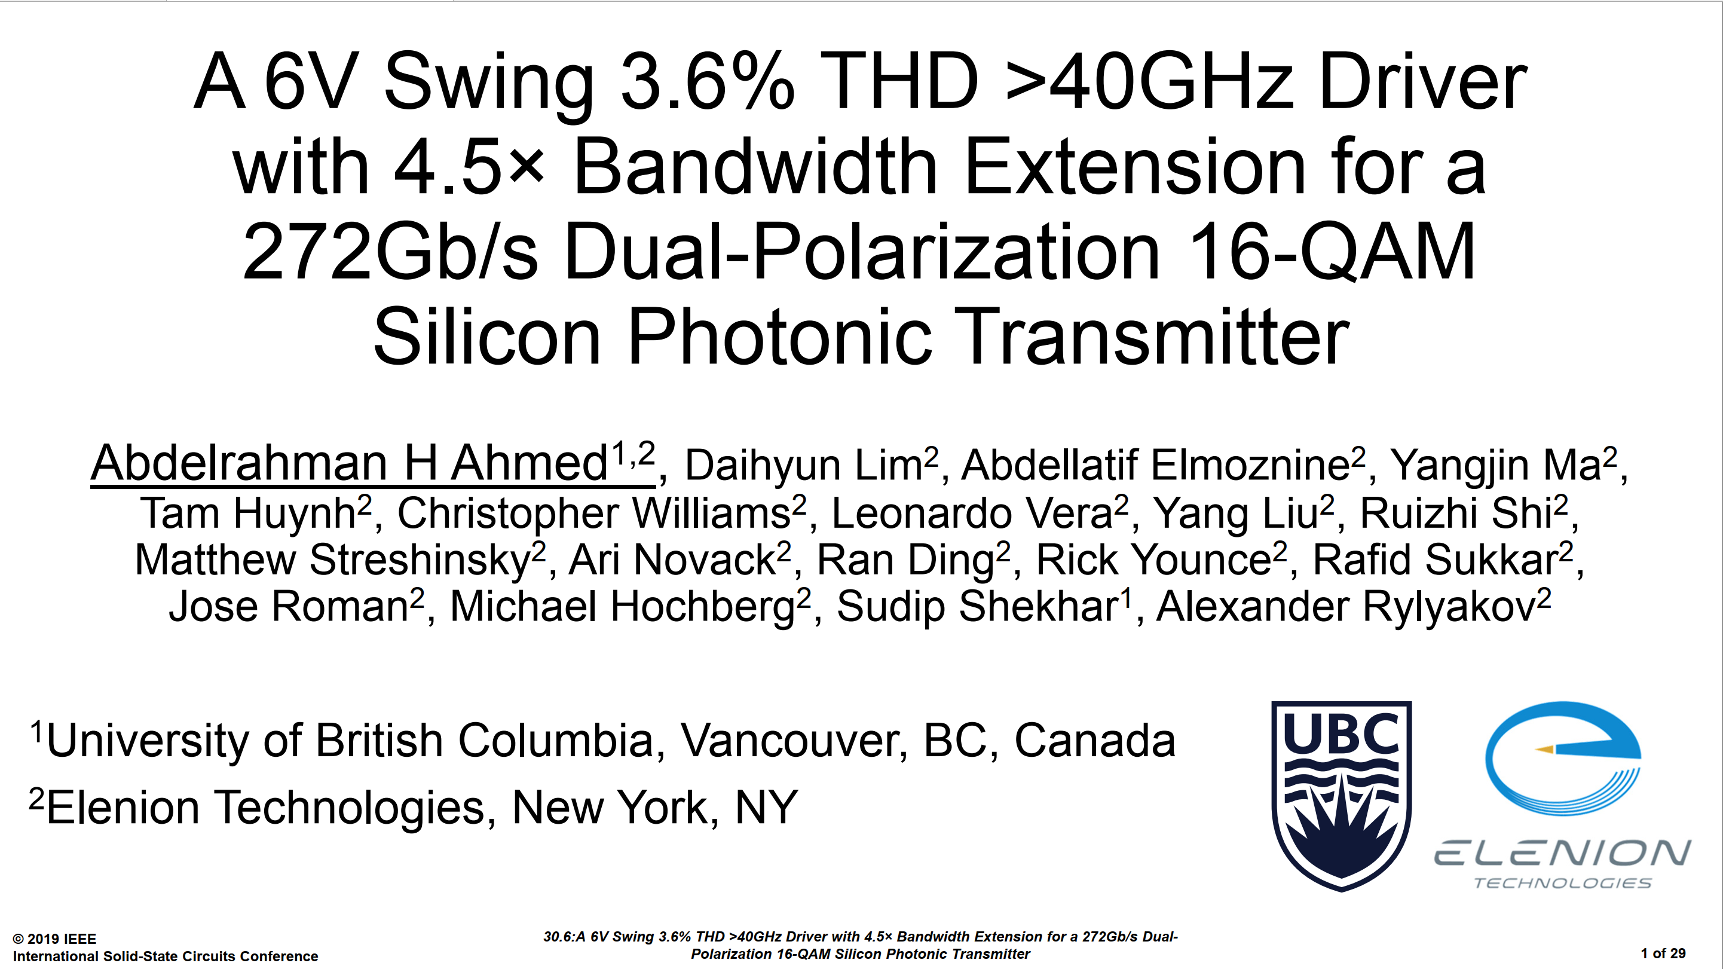


1/41

Slide 3
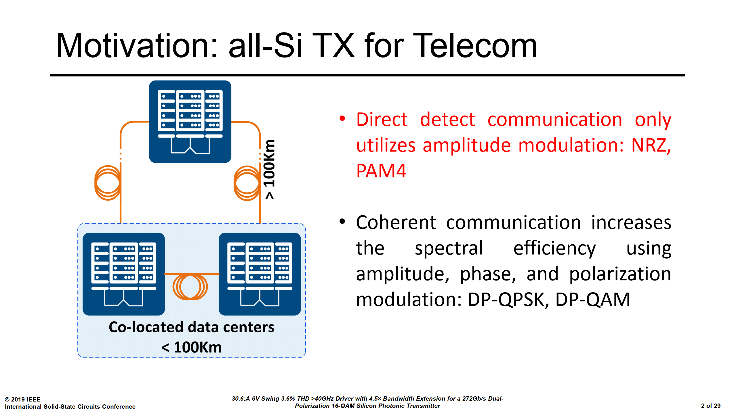
2/41

Slide 4
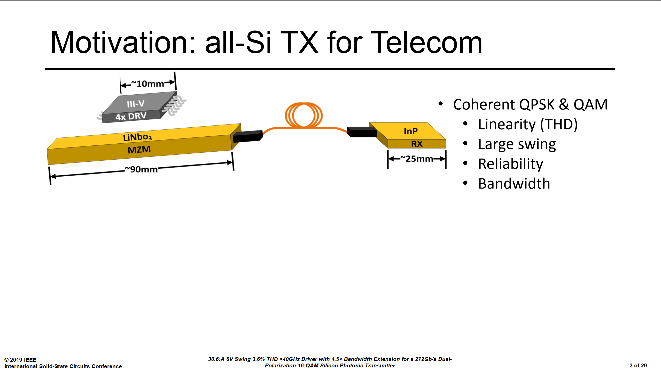
Traditionally, the high-performance optical coherent communication TX has been a discrete assembly based on LiNbO3 modulators and III-V drivers.
Bulky
Discrete Assembly
Doesn’t work for high-volume or intra center application
3/41

Slide 5
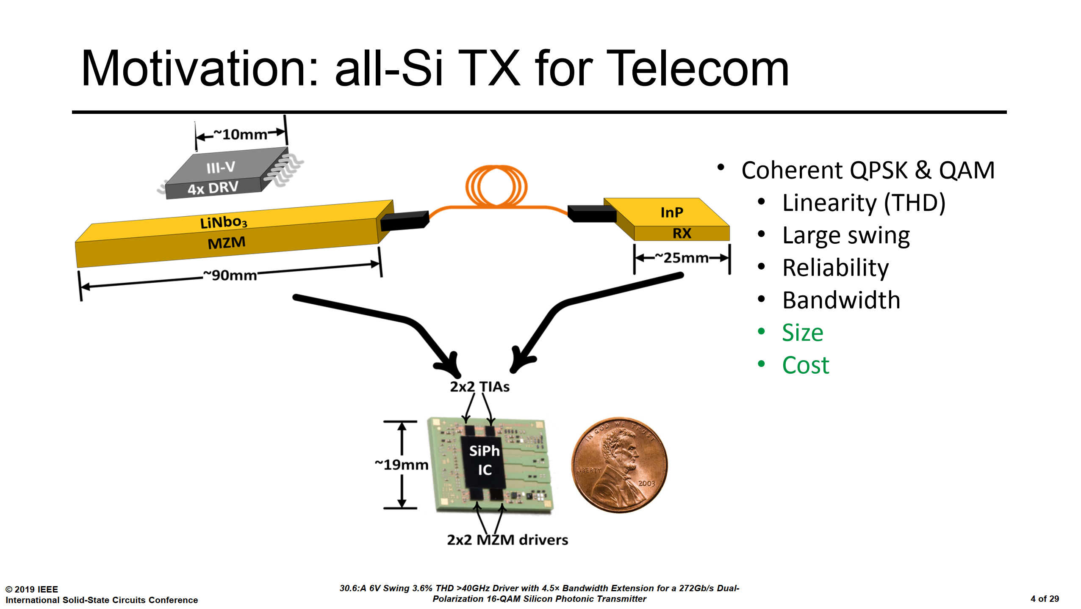
130nm SiGe
4/41

Slide 6
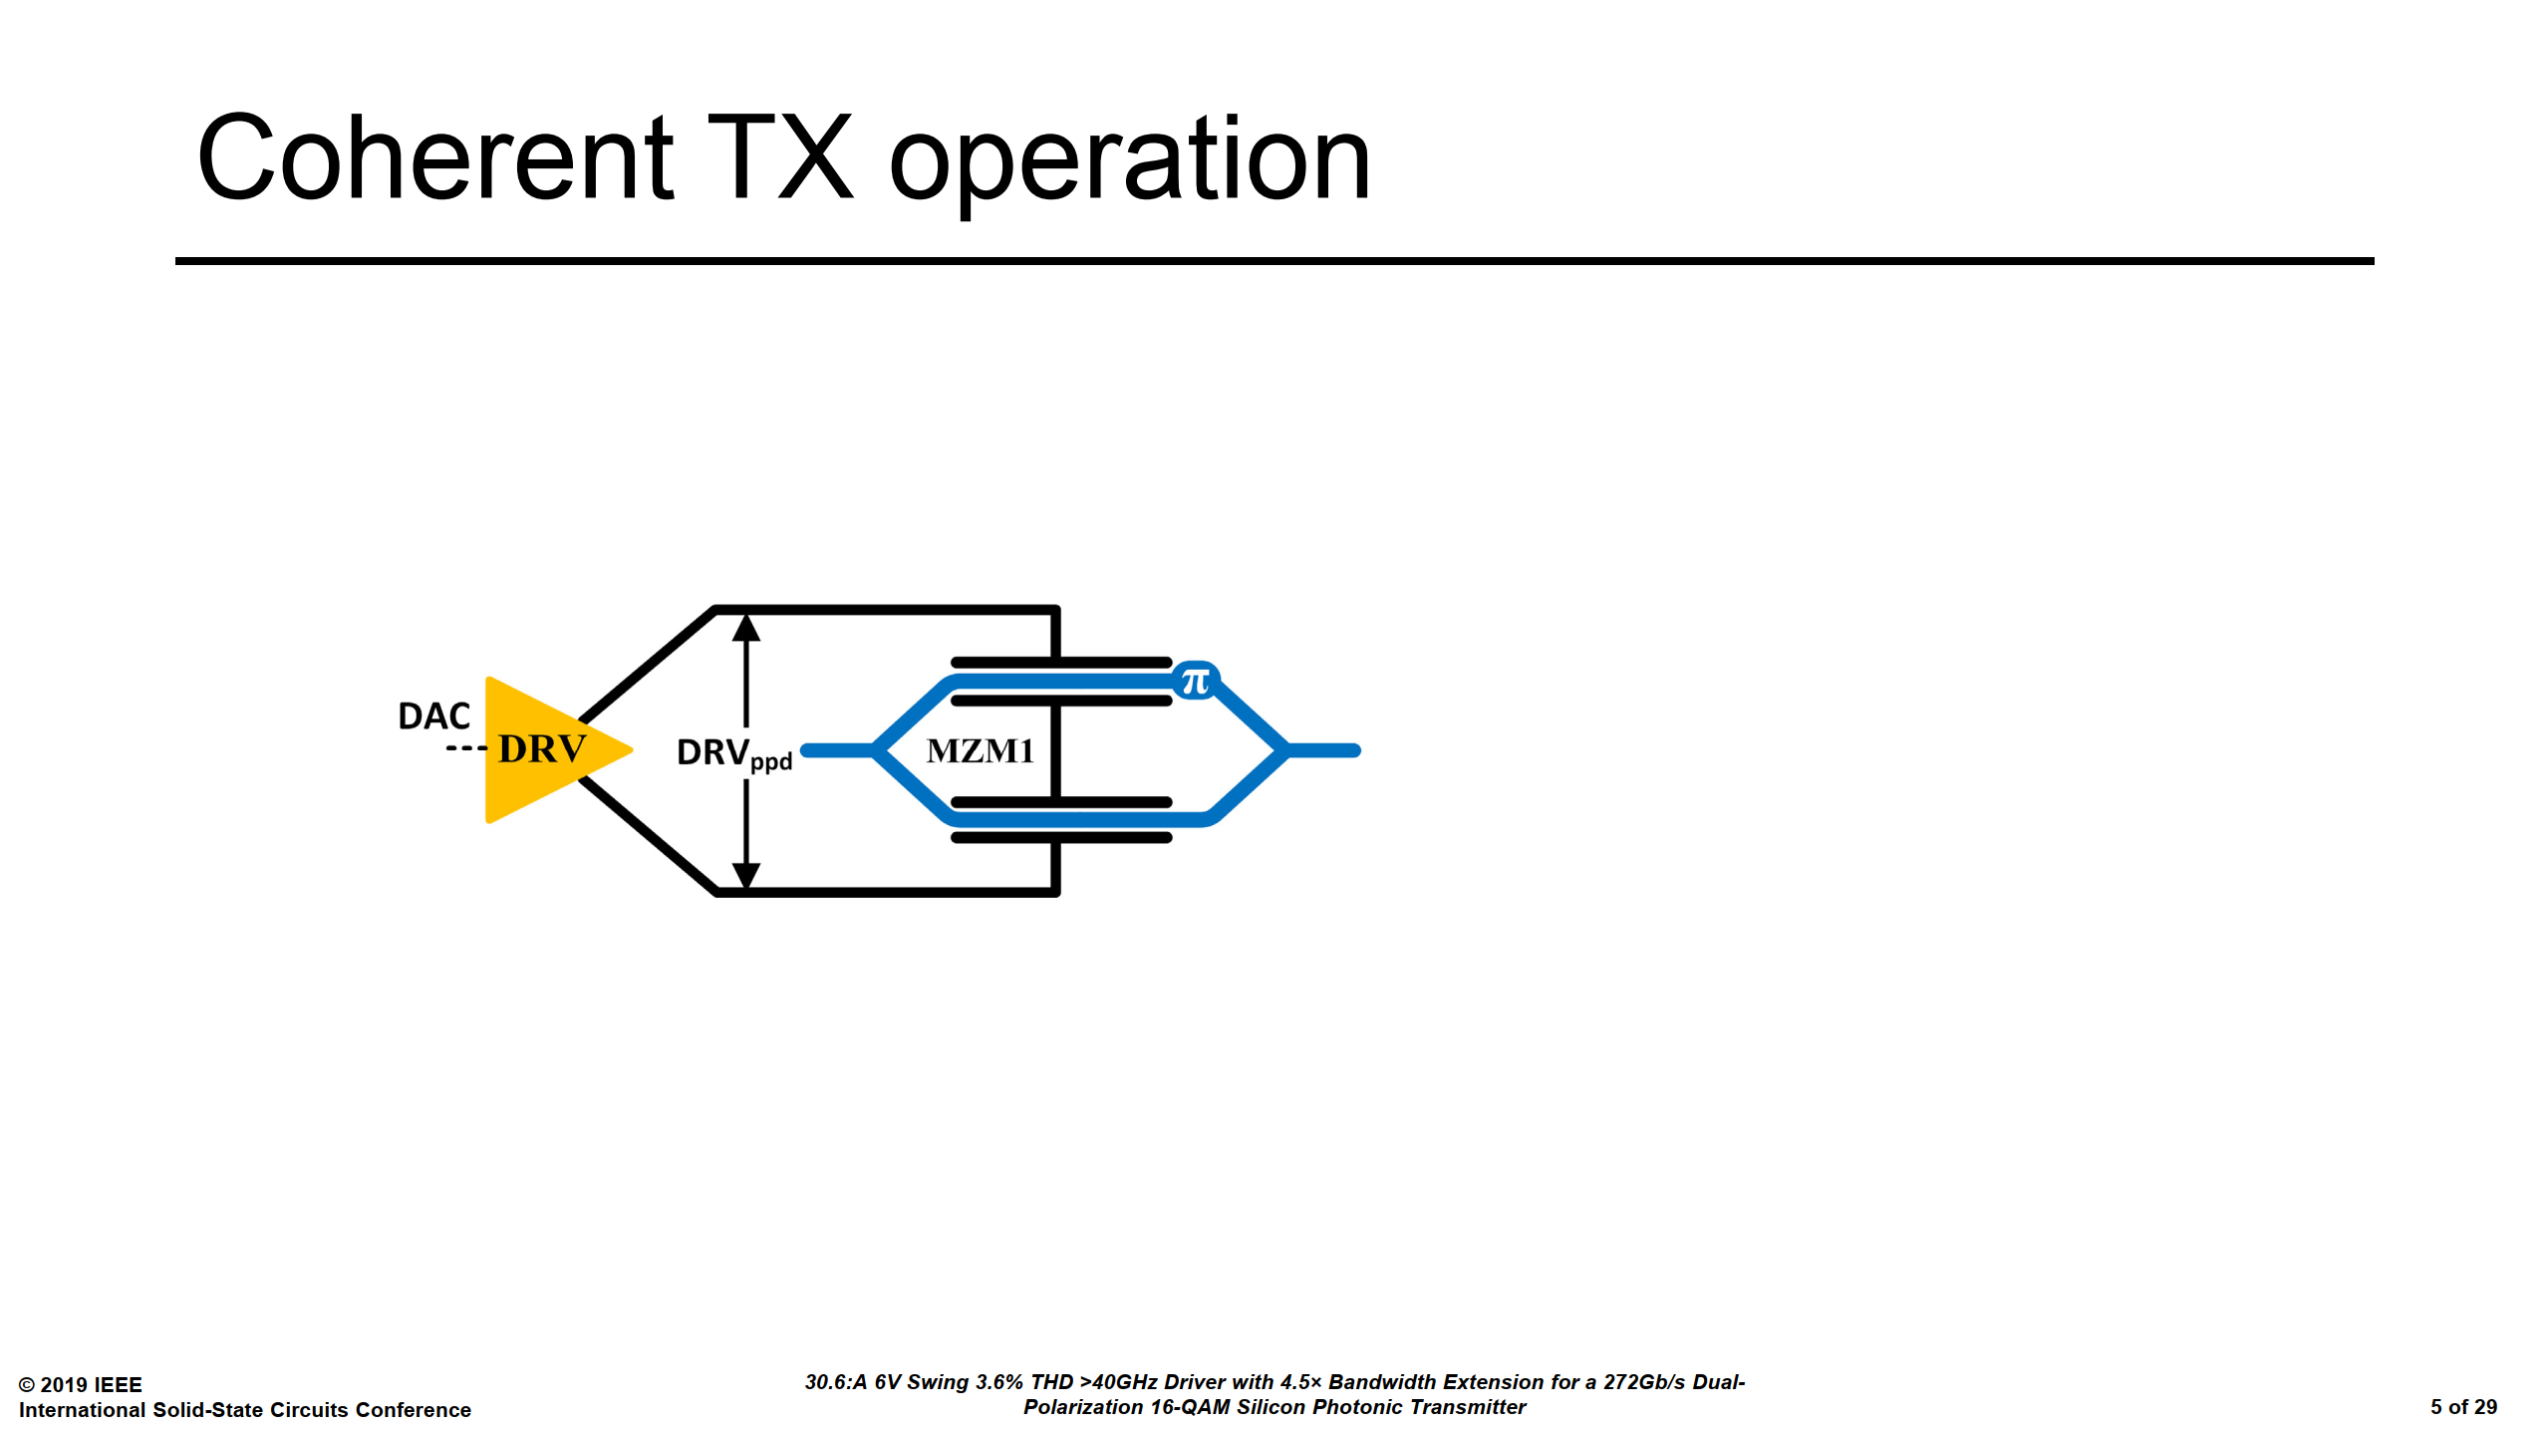
5/41

Slide 7
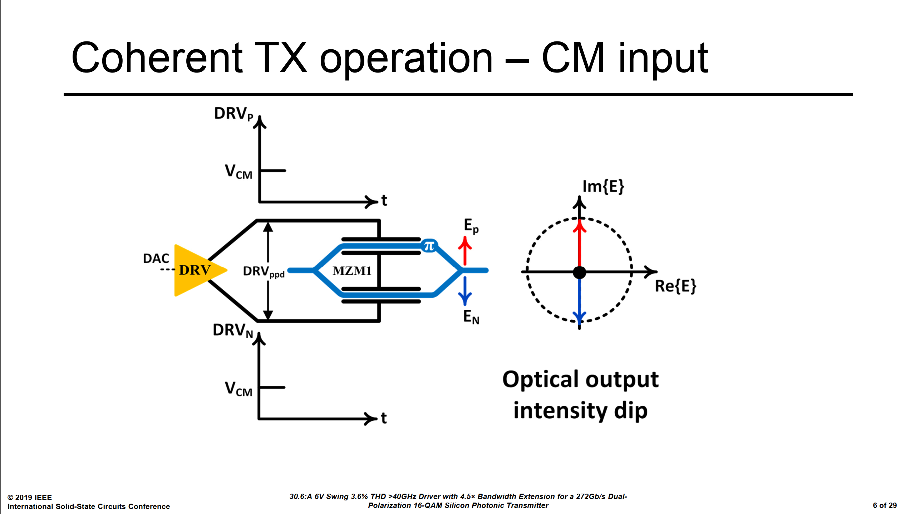
6/41

Slide 8
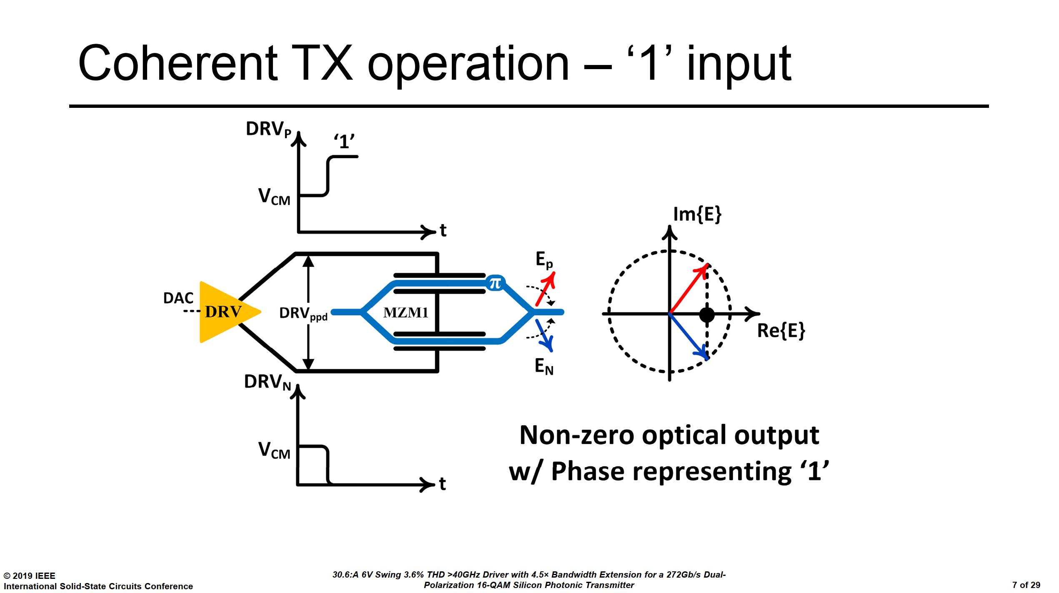
7/41

Slide 9
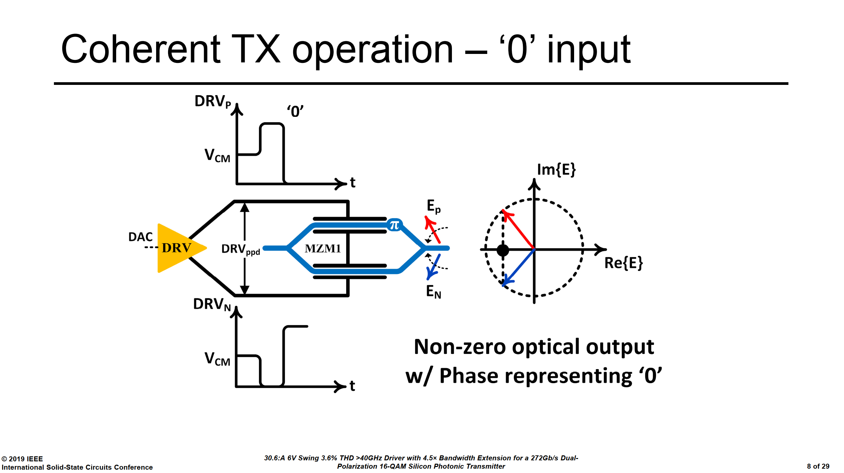
8/41

Slide 10
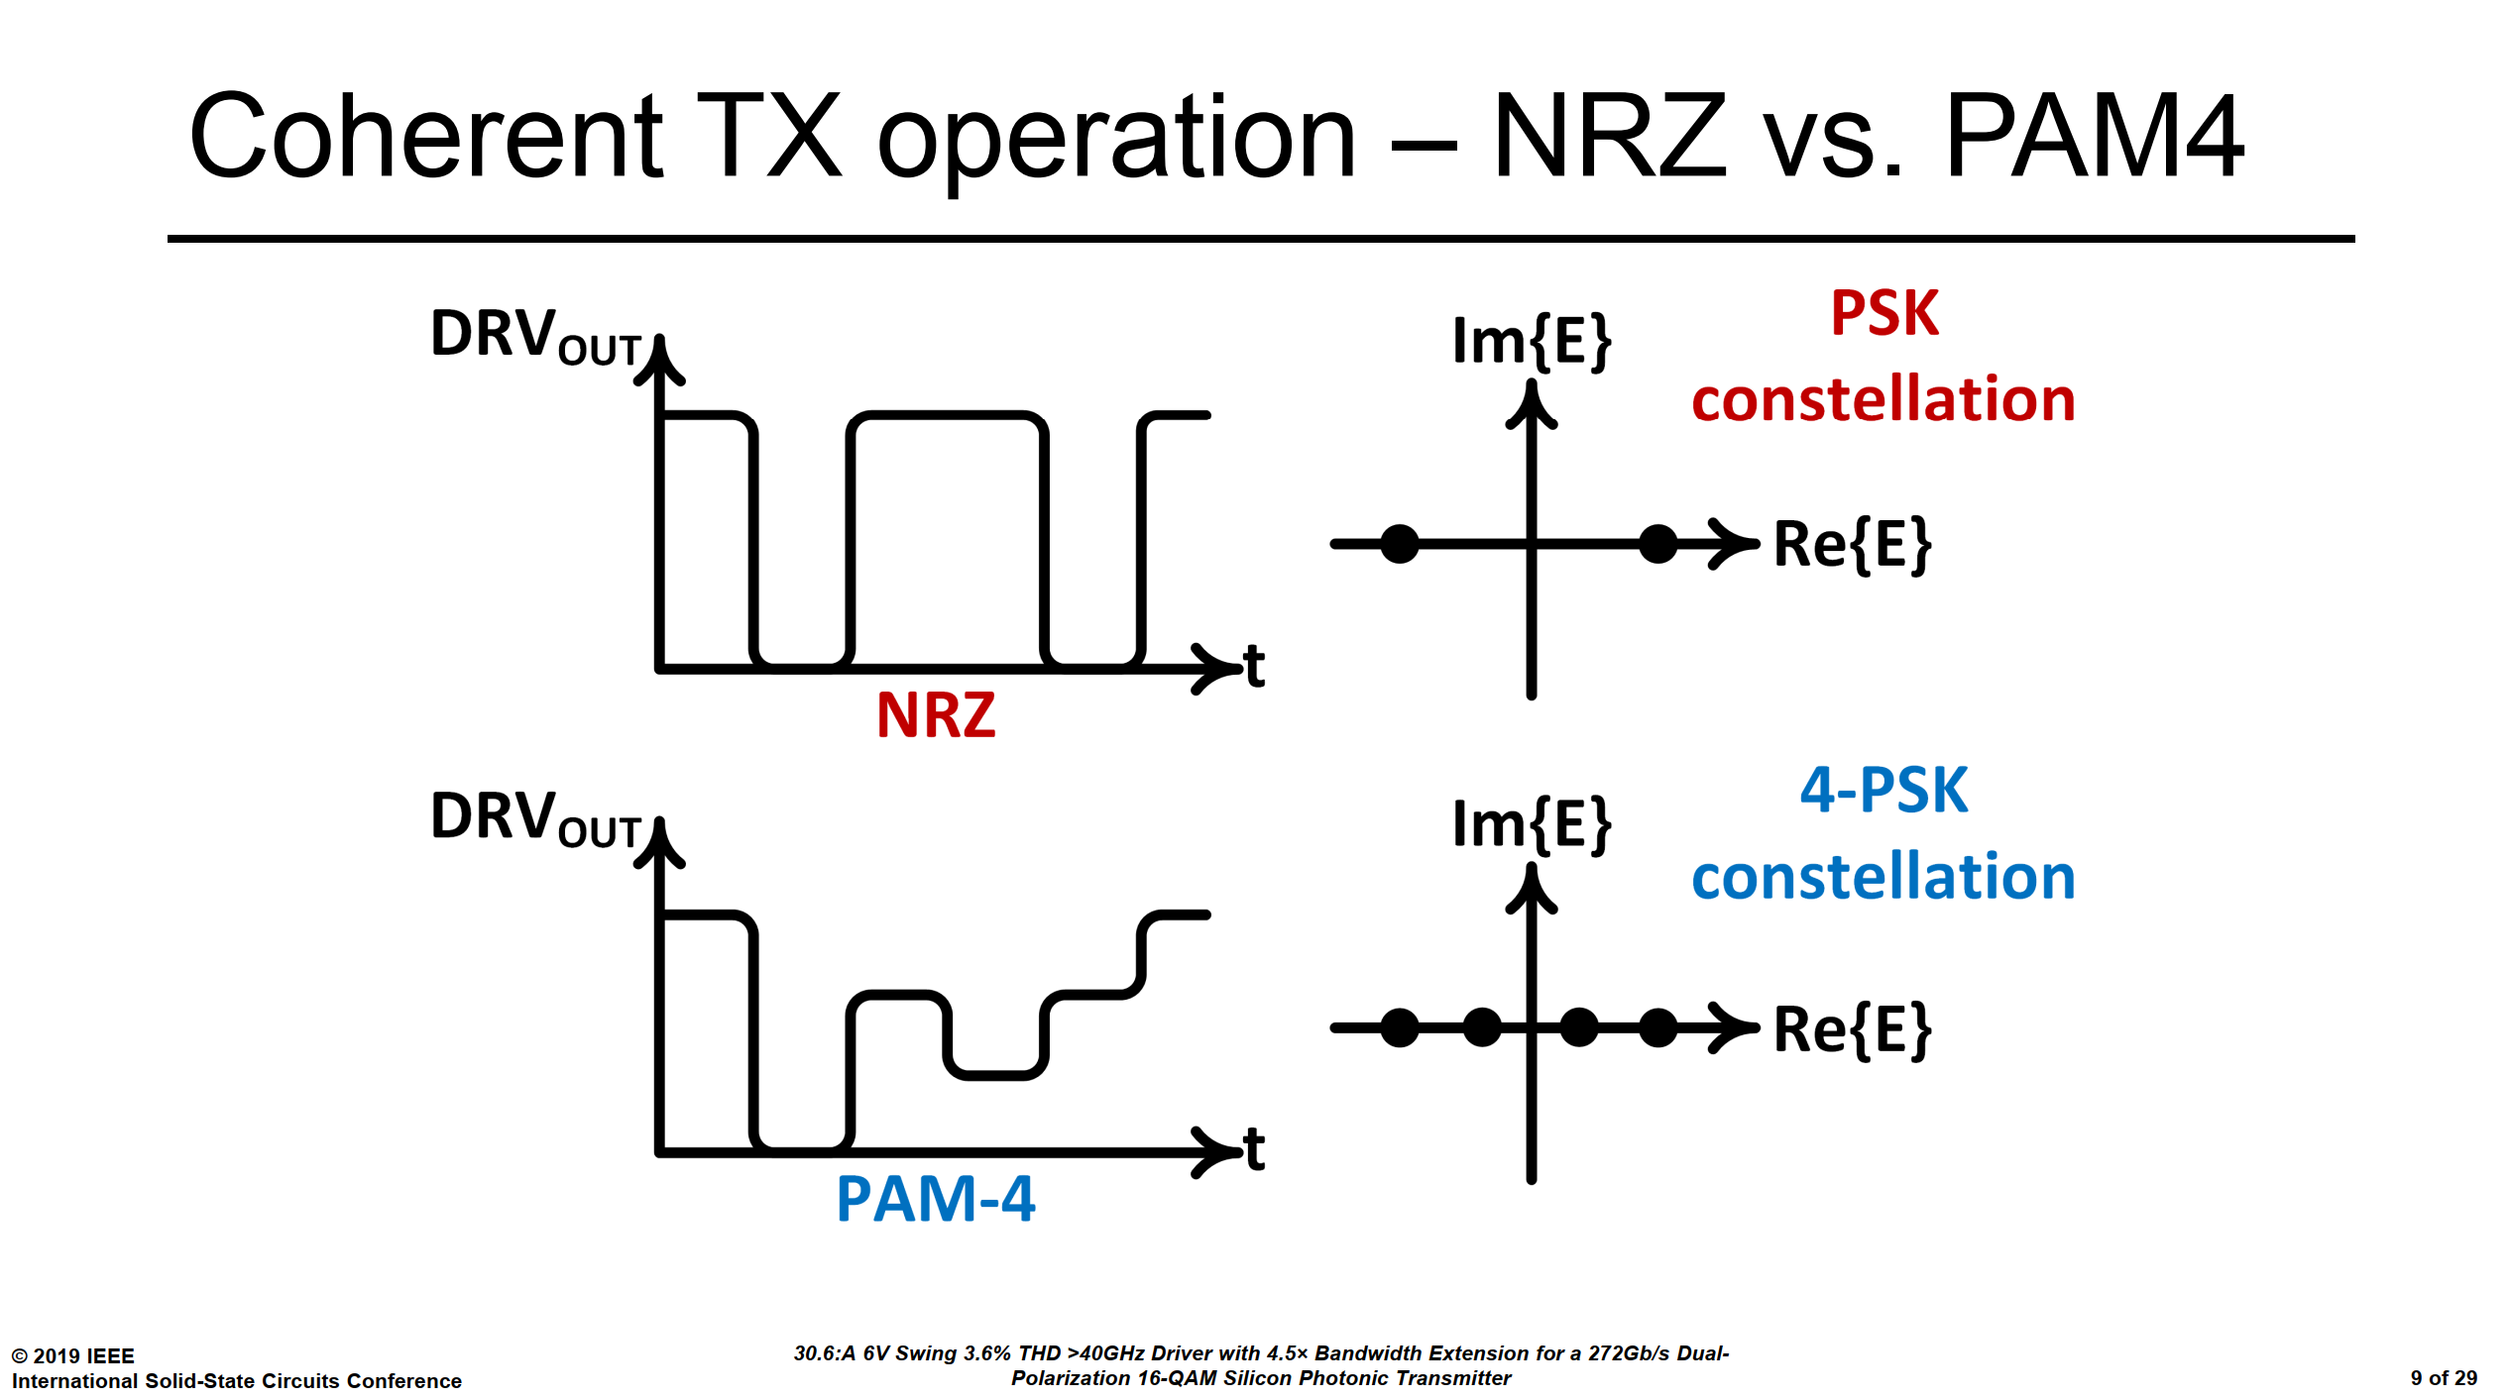
9/41

Slide 11
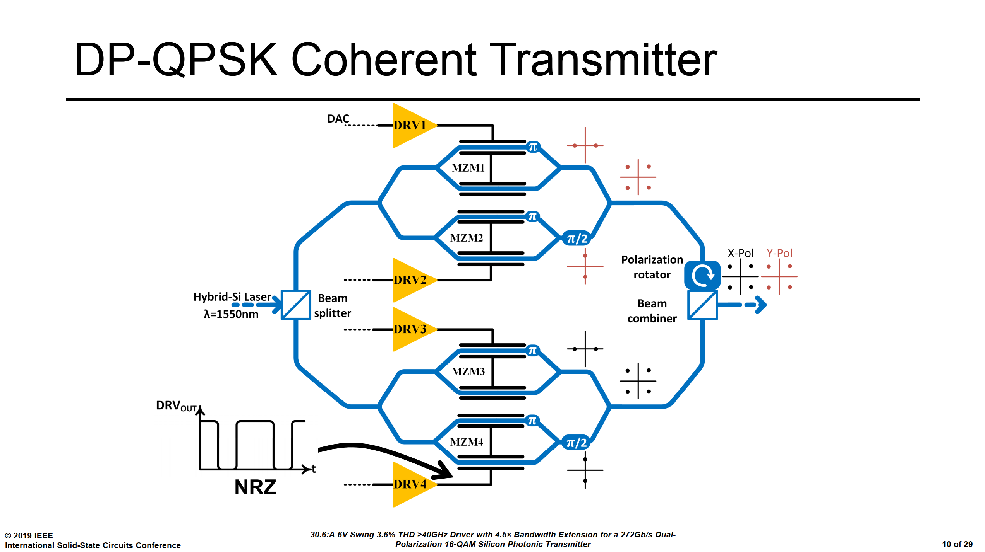
10/41

Slide 12
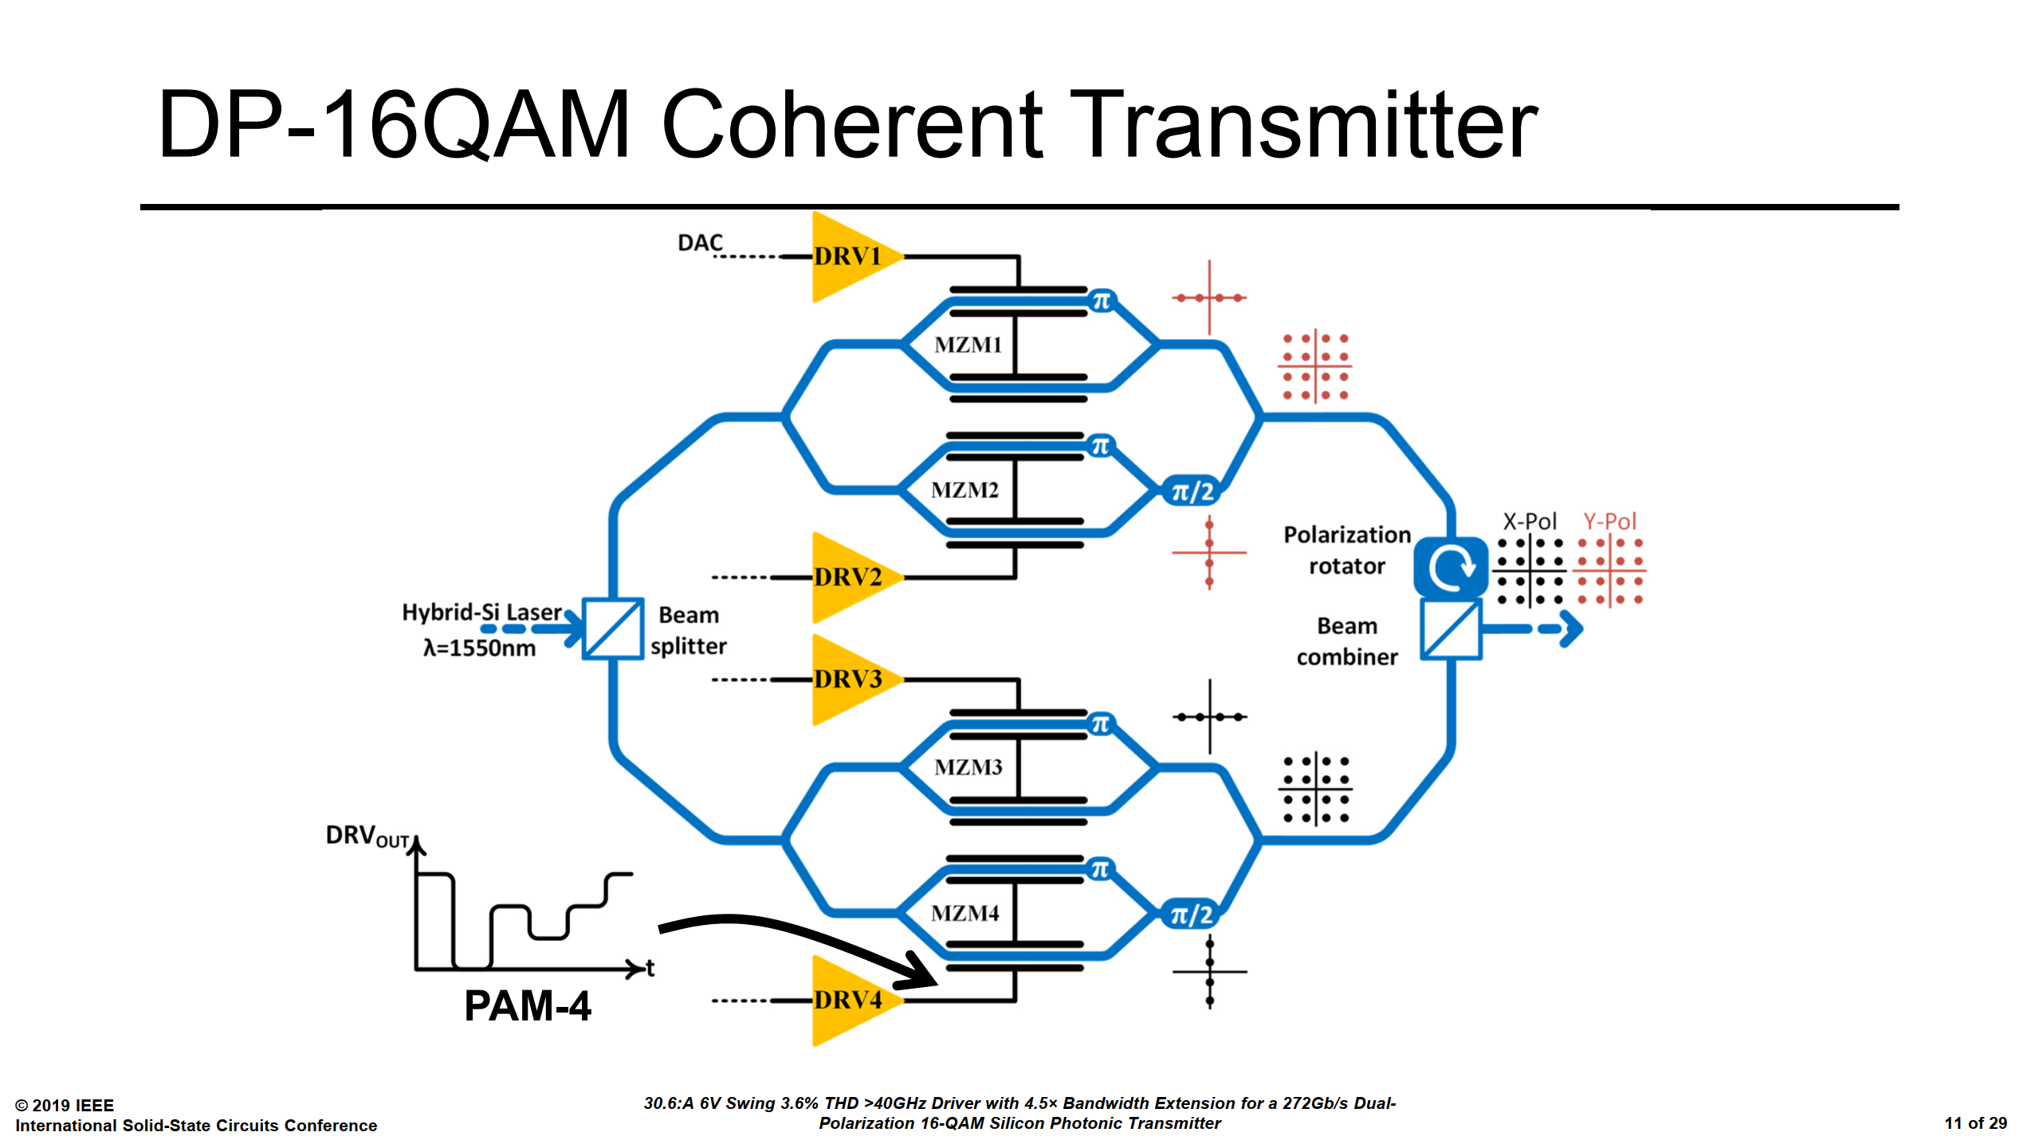
11/41

Slide 13
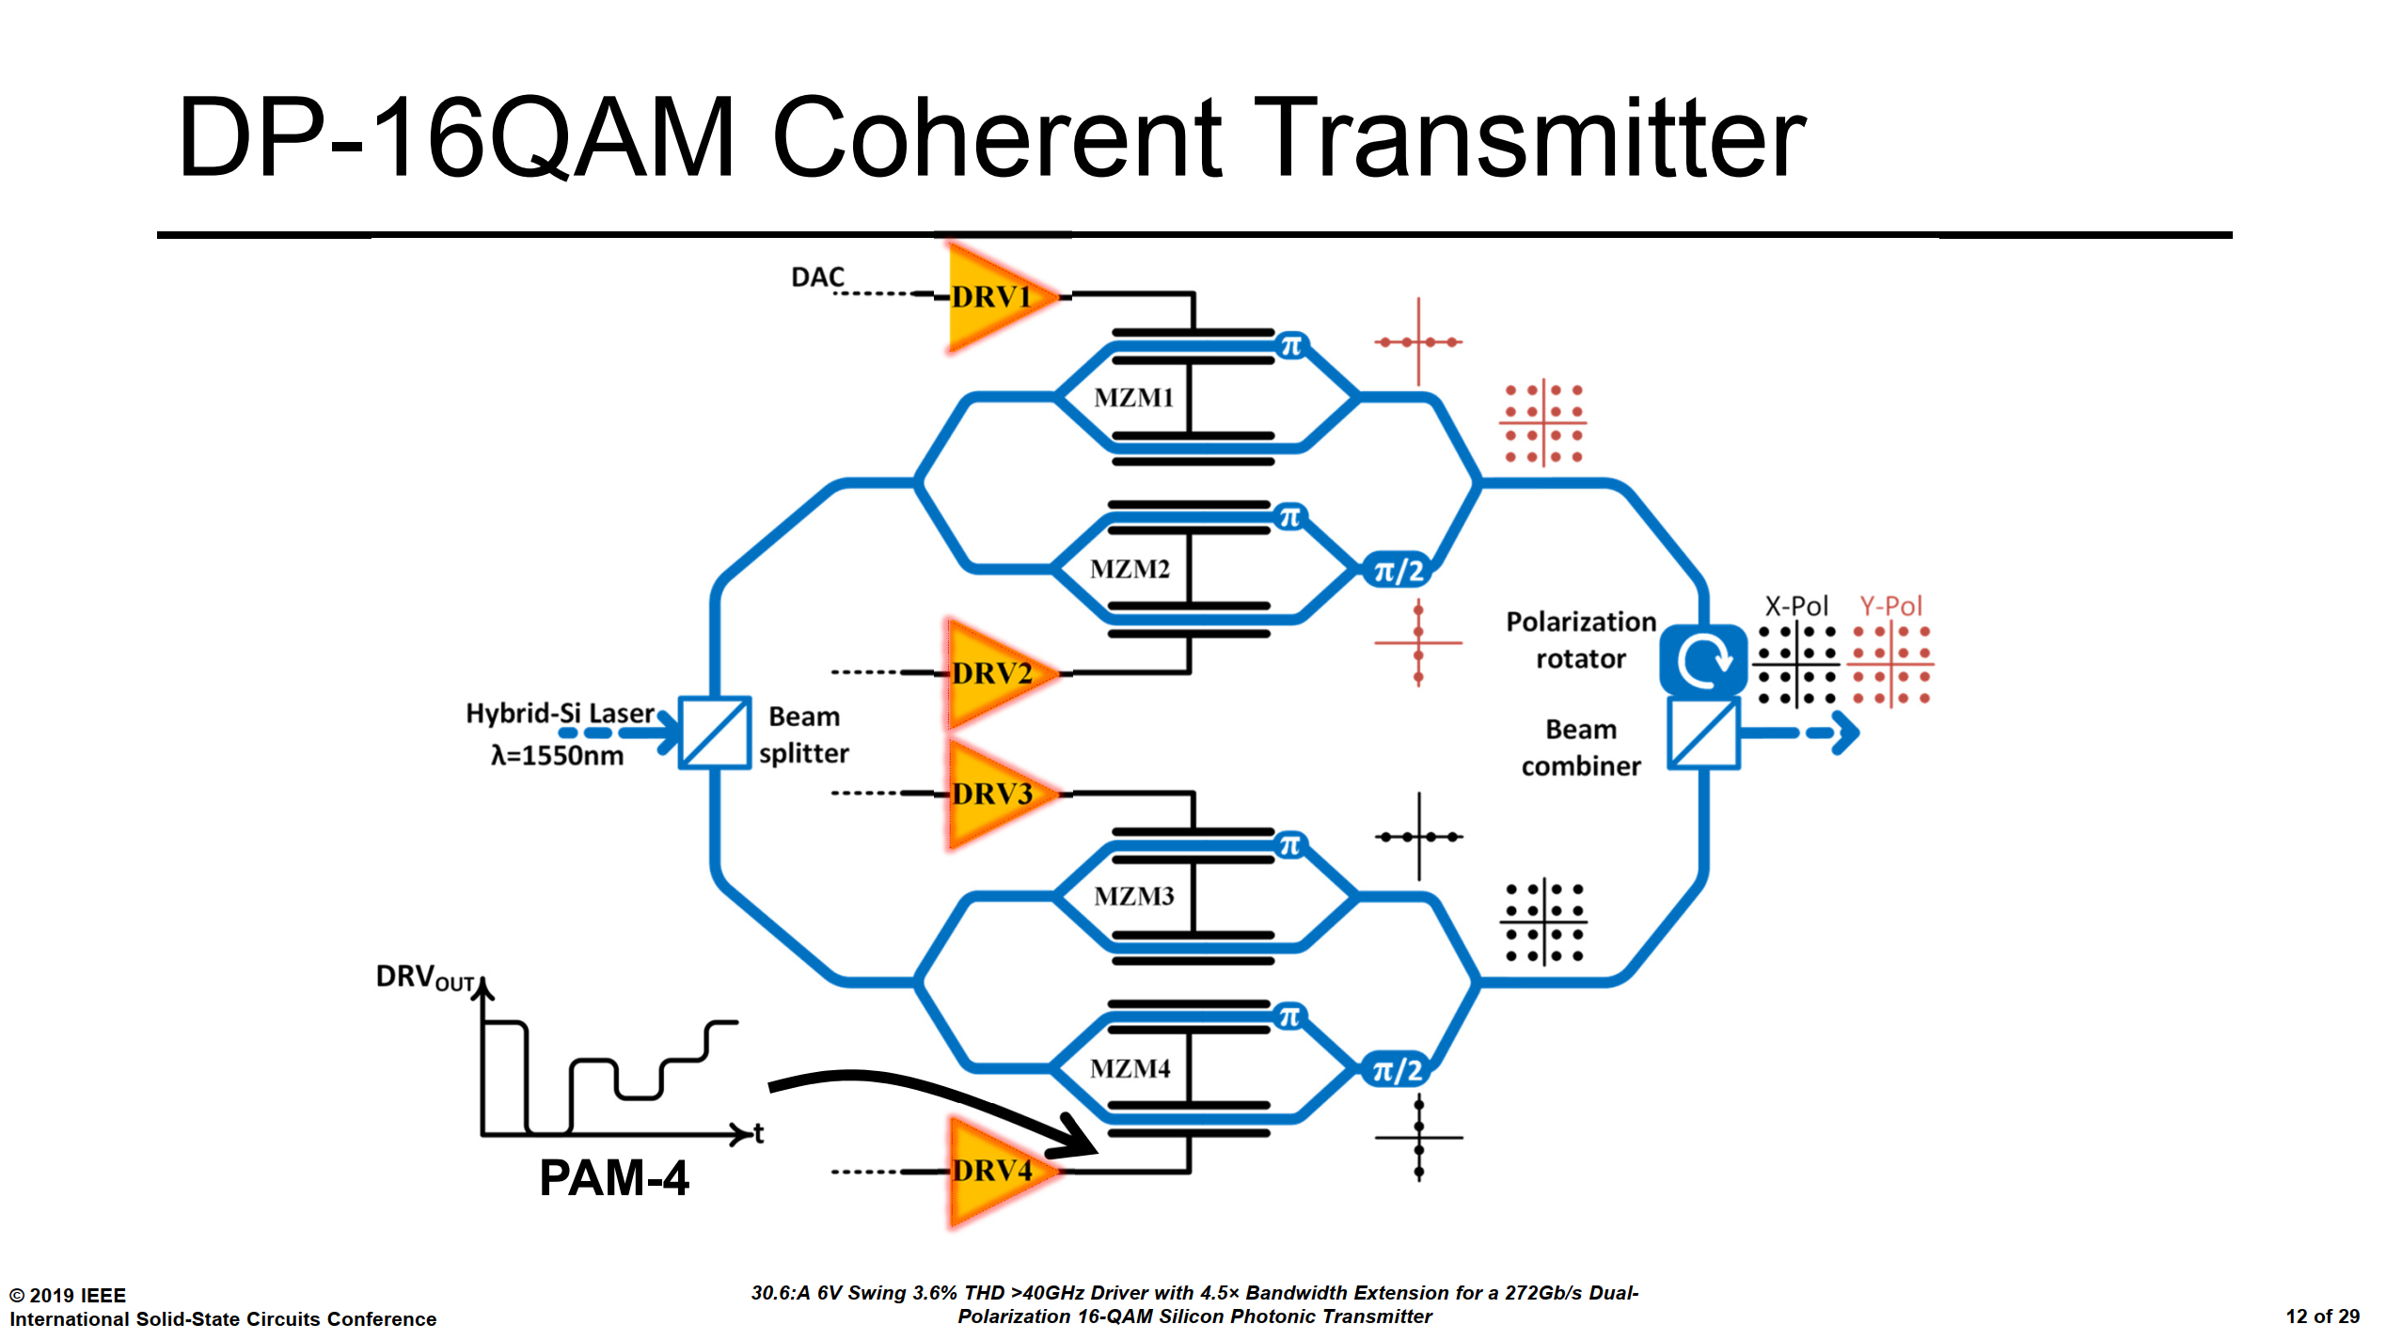
12/41

Slide 14
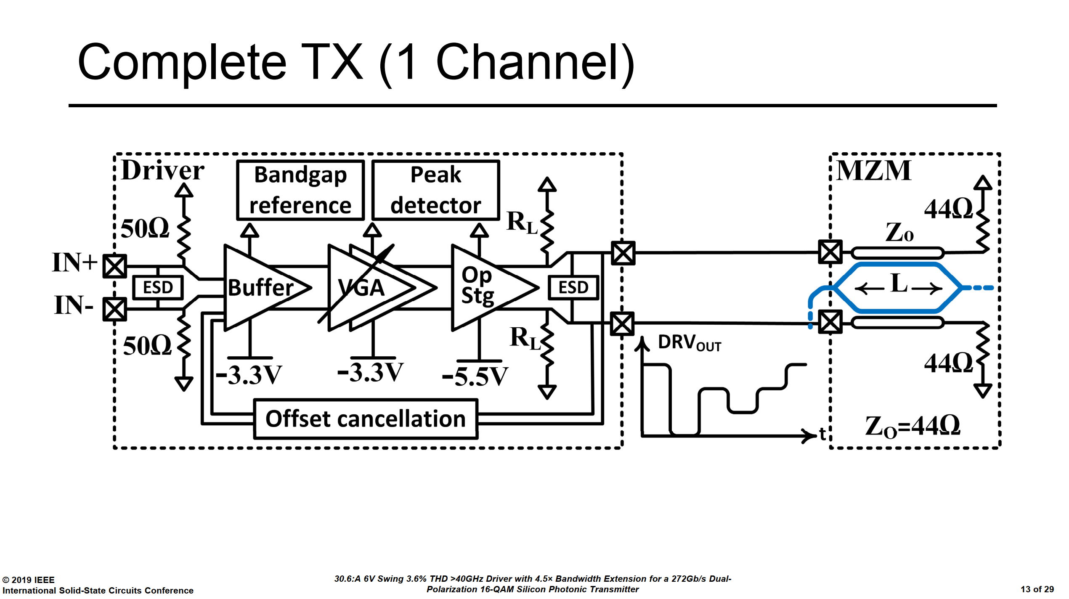
1.65V BVCEO BiCMOS Process
13/41

Slide 15

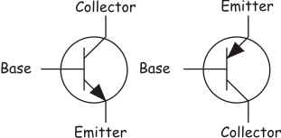
Additional Explanations [ Mandegaran and Hajimiri JSSCC 2007 ]
Main Limiting Factor
14/41

Slide 16
Additional Explanations [ Mandegaran and Hajimiri JSSCC 2007 ]
SCALING
BECOME FASTER
BECOME LESS TOLERANT OF HIGH VOLTAGE
15/41

Slide 17
Additional Explanations [ Mandegaran and Hajimiri JSSCC 2007 ]
BVCEO Vs BVCER
Worst Case
Most Reported Value
Most Important Value
16/41

Slide 18
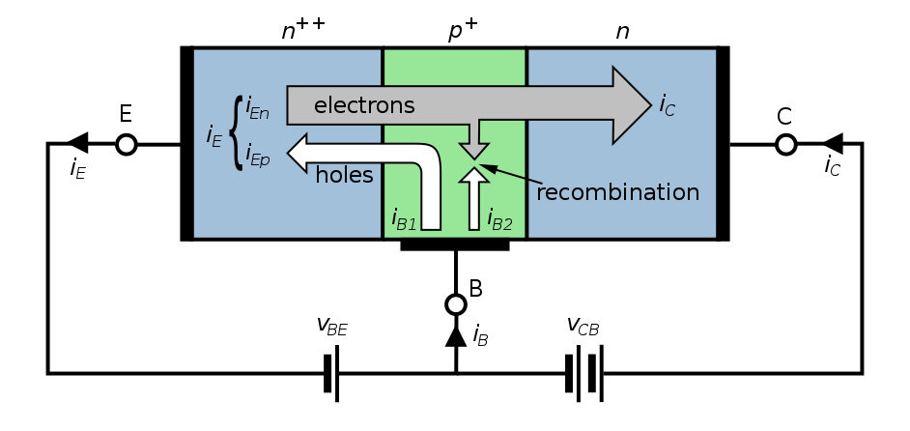
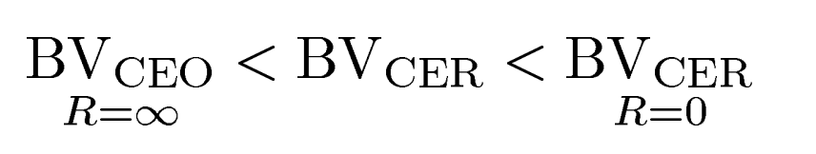
Additional Explanations [ Mandegaran and Hajimiri JSSCC 2007 ]
17/41

Slide 19
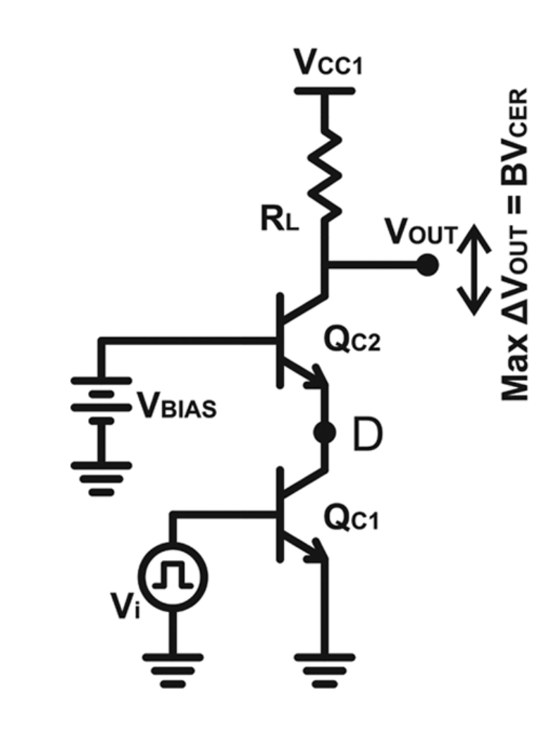
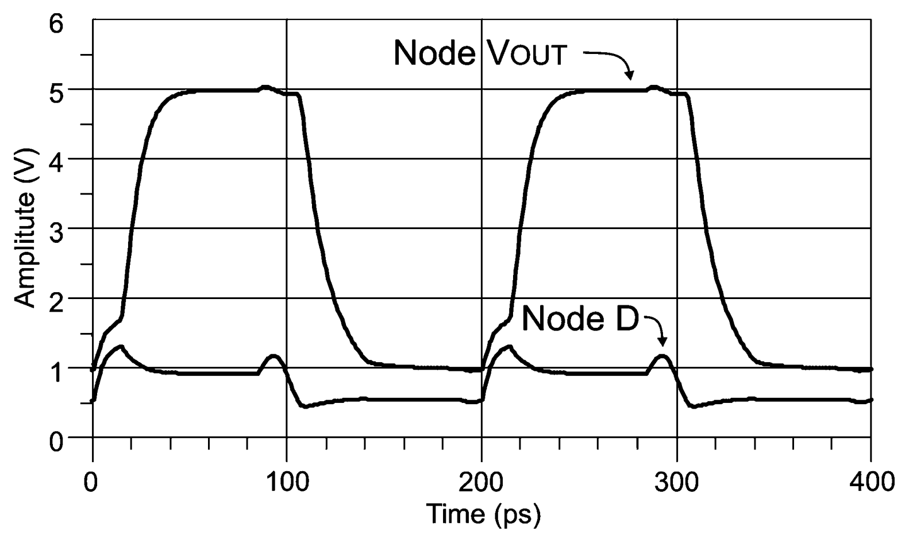
Additional Explanations [ Mandegaran and Hajimiri JSSCC 2007 ]
18/41

Slide 20
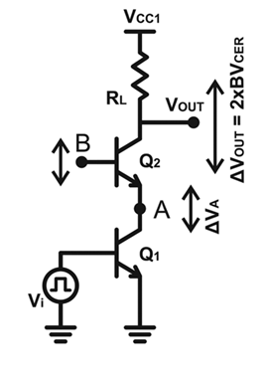
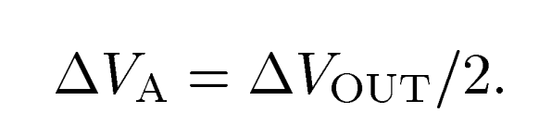
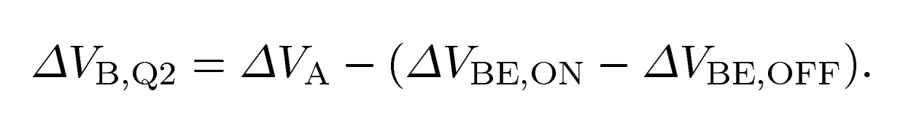
Additional Explanations [ Mandegaran and Hajimiri JSSCC 2007 ]
19/41

Slide 21
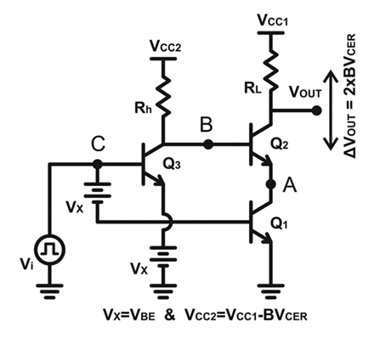
Additional Explanations [ Mandegaran and Hajimiri JSSCC 2007 ]
20/41

Slide 22
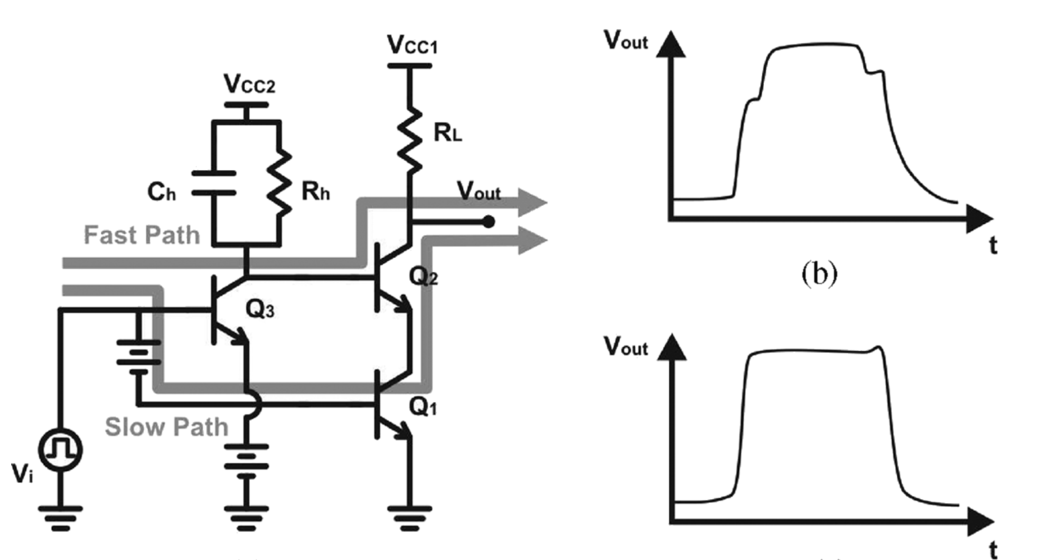
Additional Explanations [ Mandegaran and Hajimiri JSSCC 2007 ]
21/41

Slide 23
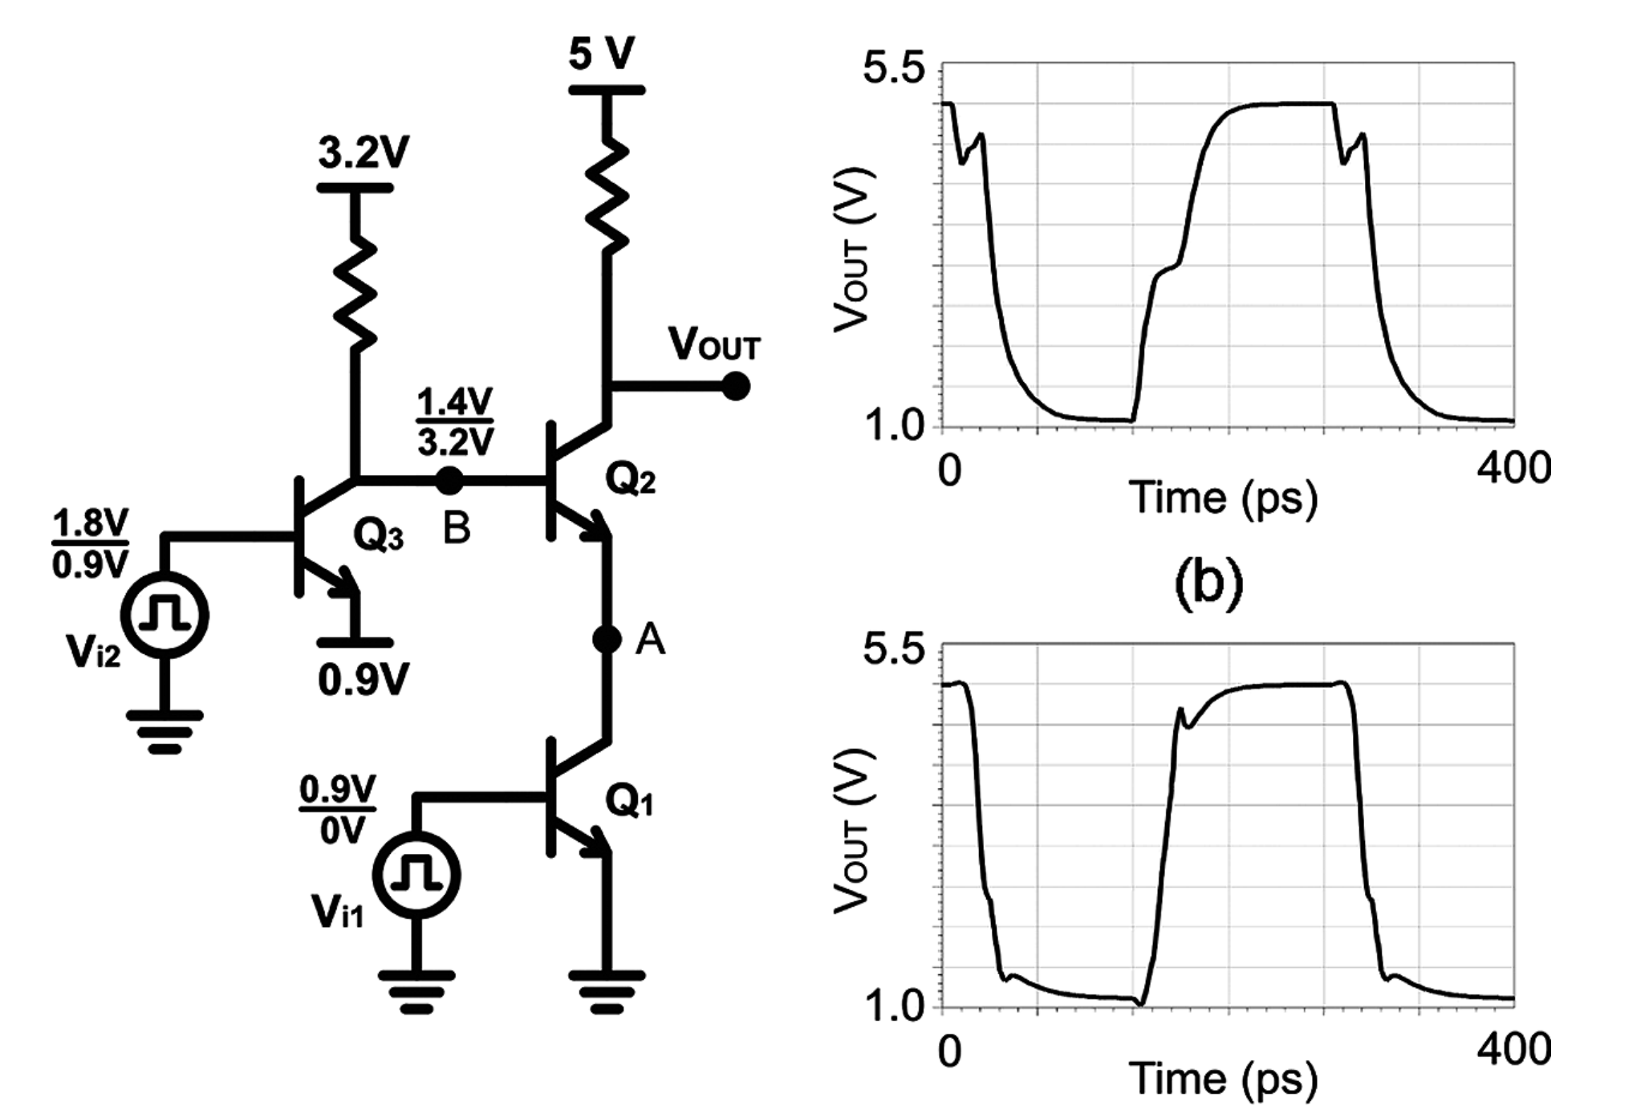
Additional Explanations [ Mandegaran and Hajimiri JSSCC 2007 ]
22/41

Slide 24
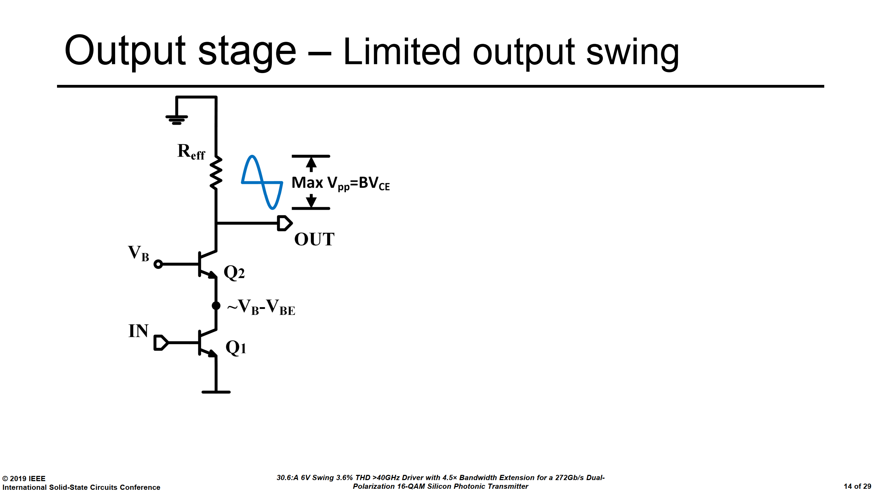
23/41

Slide 25
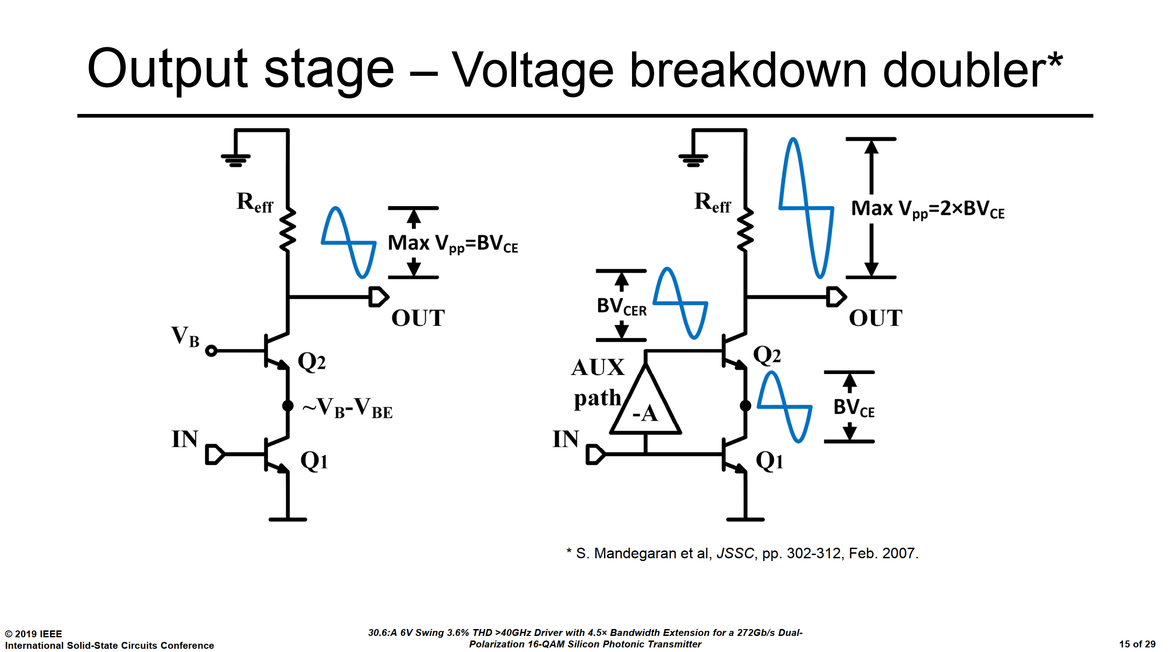
24/41

Slide 26
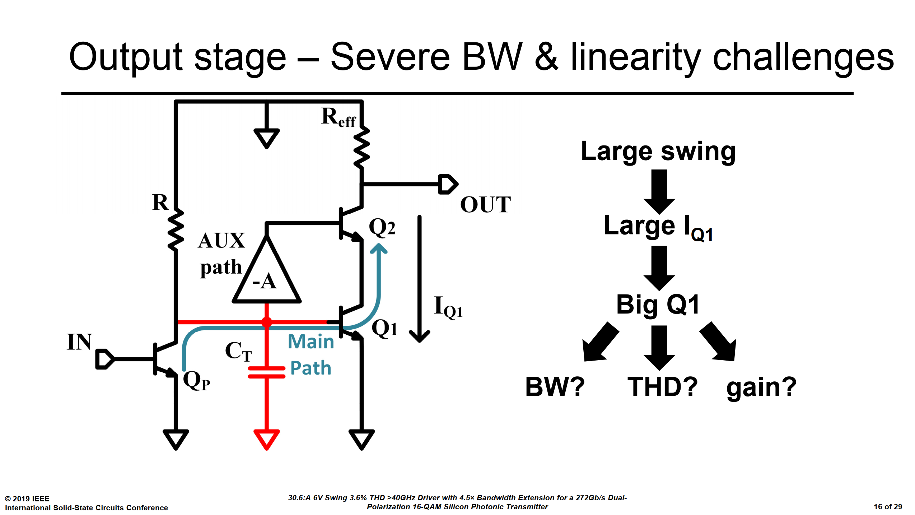
25/41

Slide 27
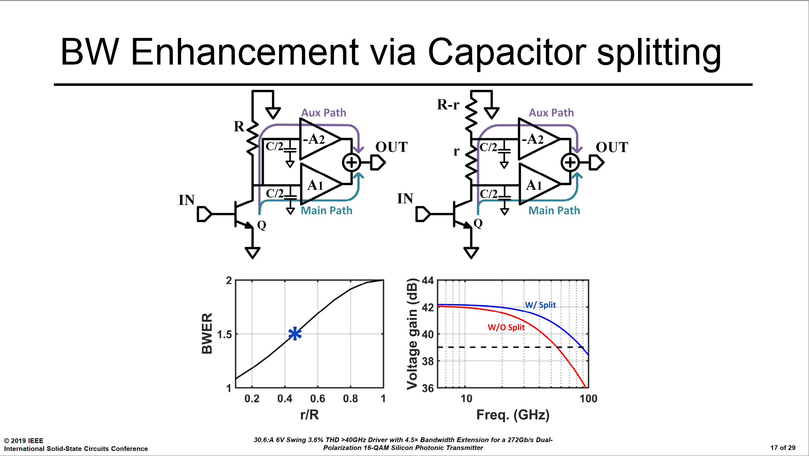
26/41

Slide 28
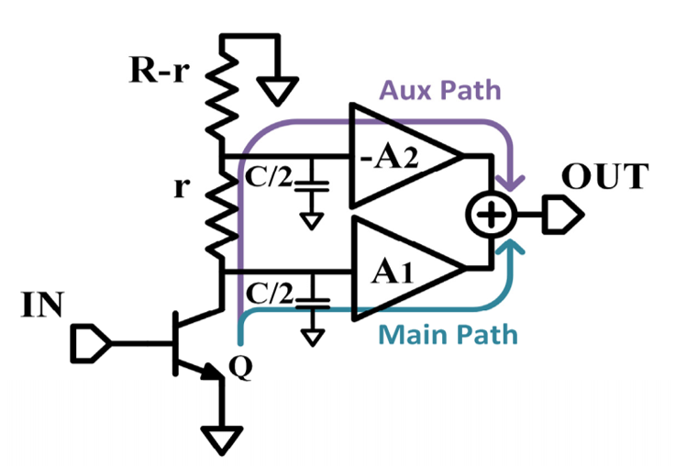
Additional Explanations [ JSSCC 2019 ]
27/41

Slide 29
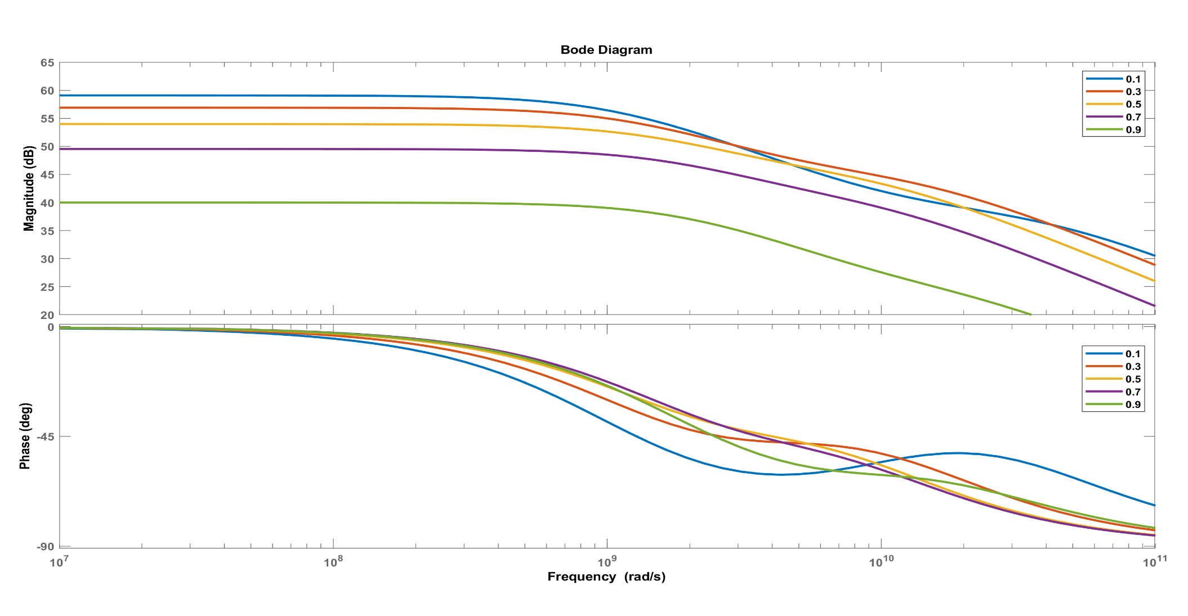
Additional Explanations [ JSSCC 2019 ]
R=1K
C=1pF
A2=1
28/41

Slide 30
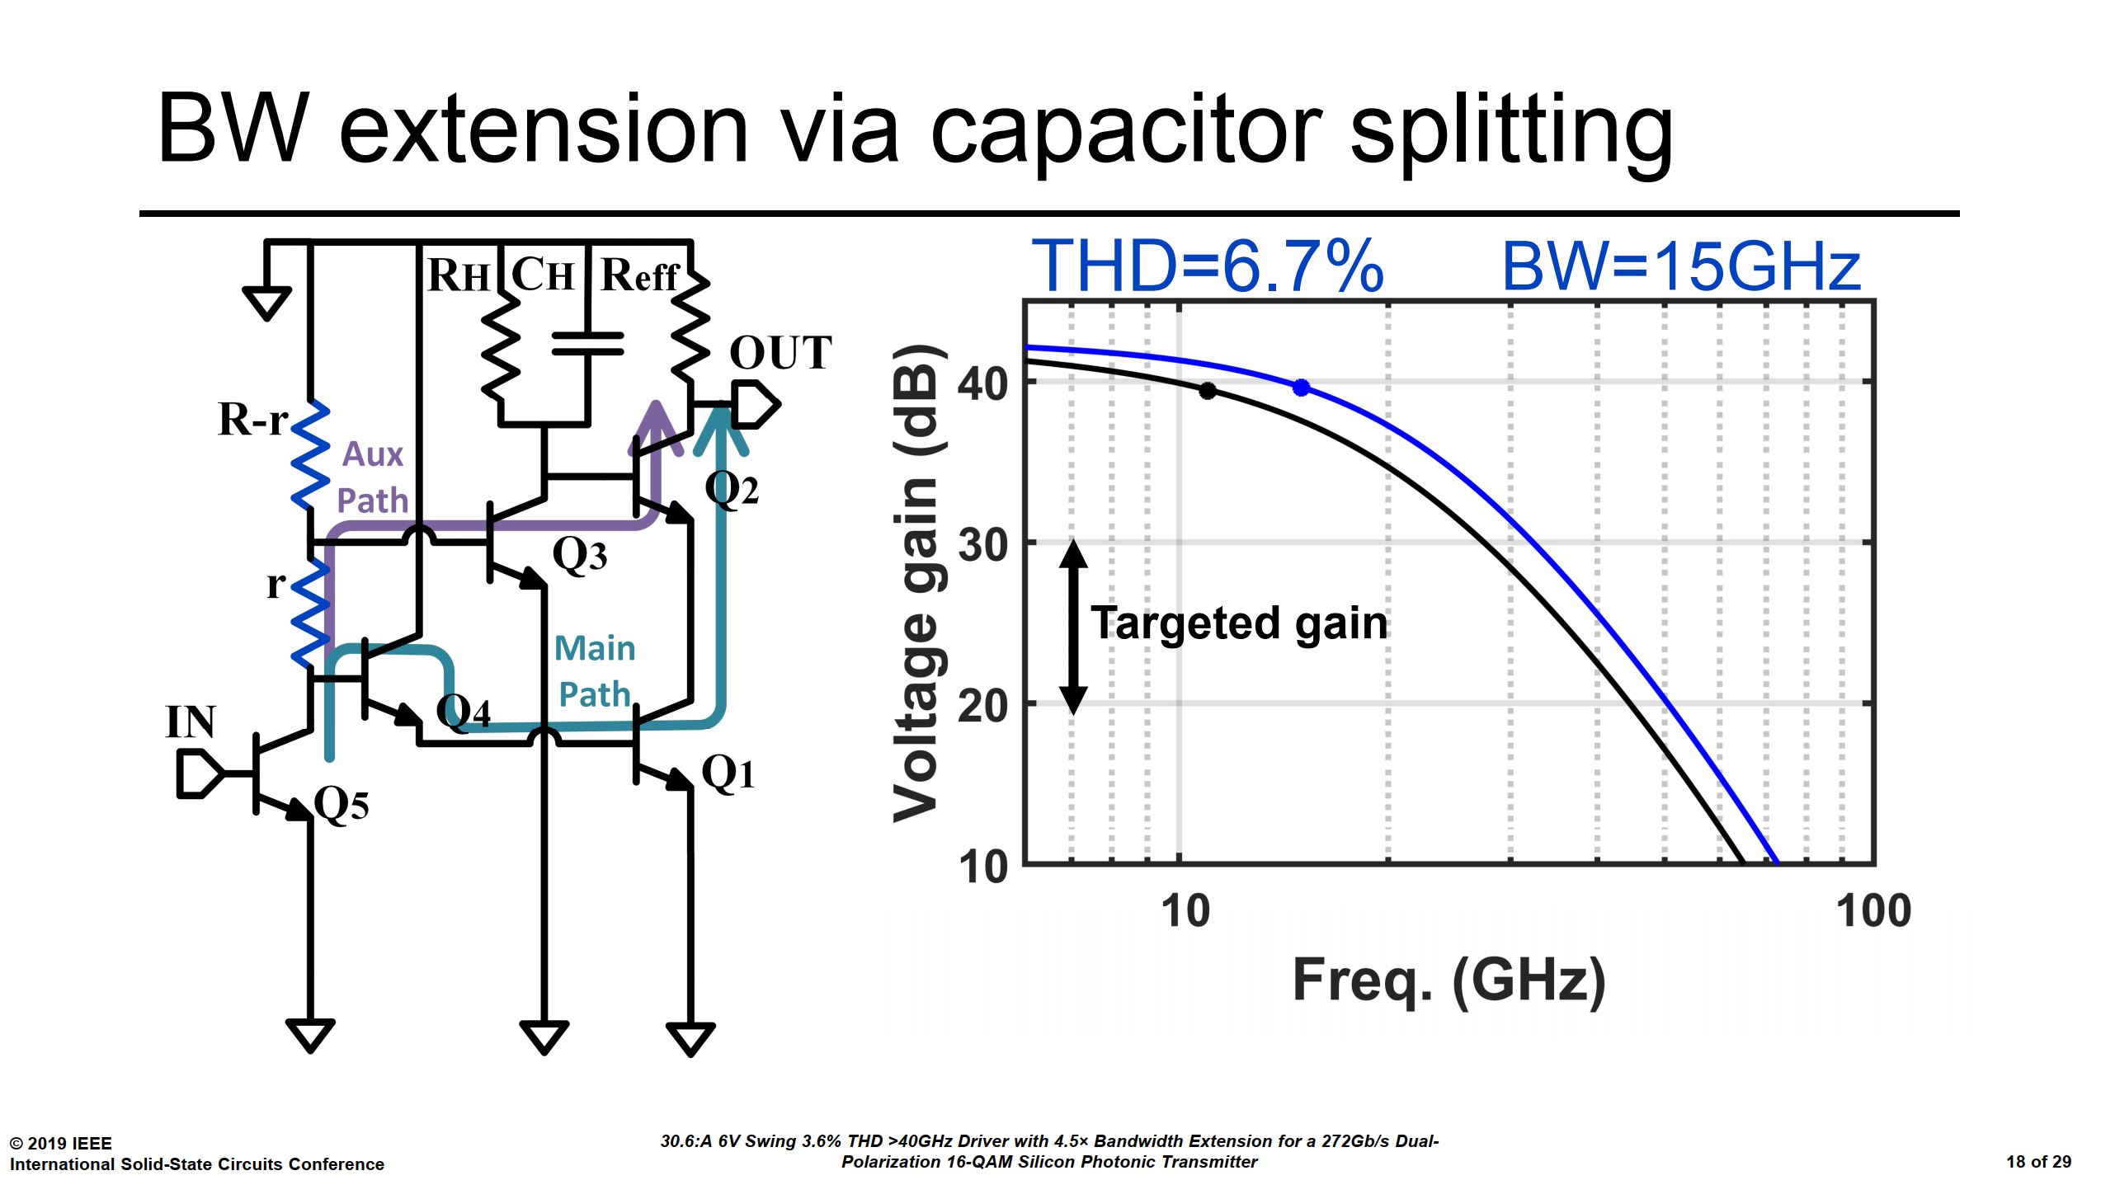
29/41

Slide 31
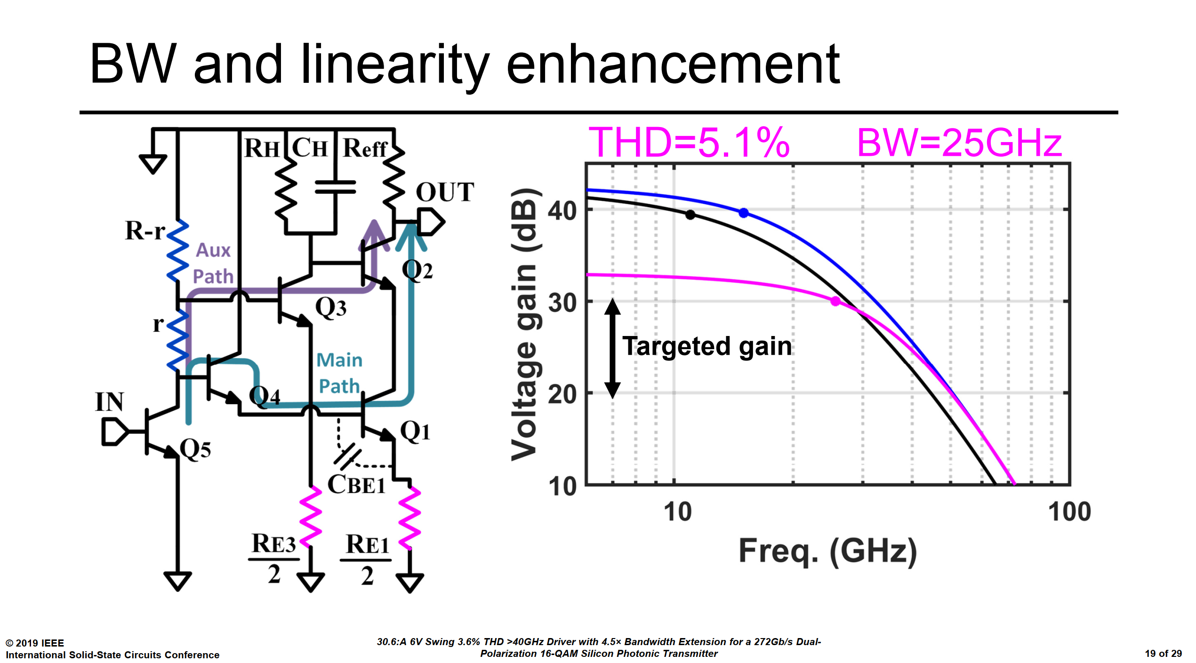
30/41

Slide 32
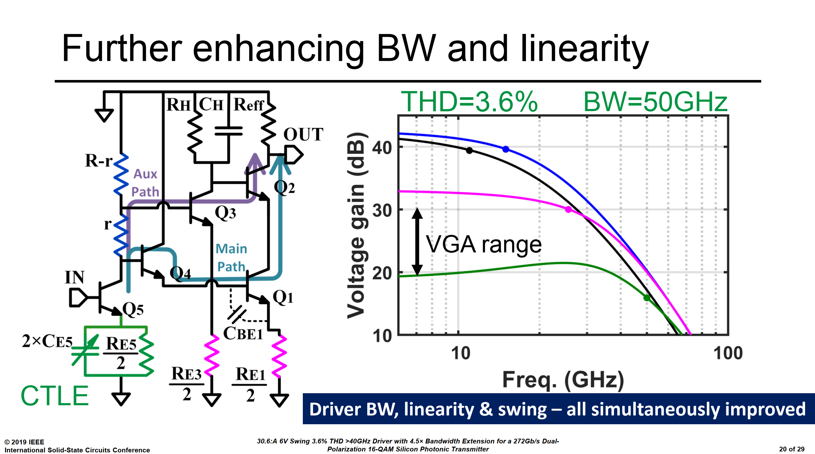
Additional Explanations [ JSSCC 2019 ]
31/41

Slide 33
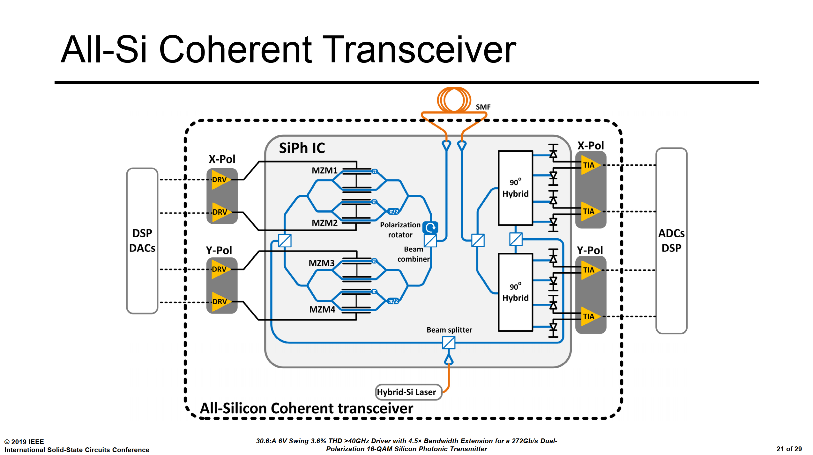
32/41

Slide 34
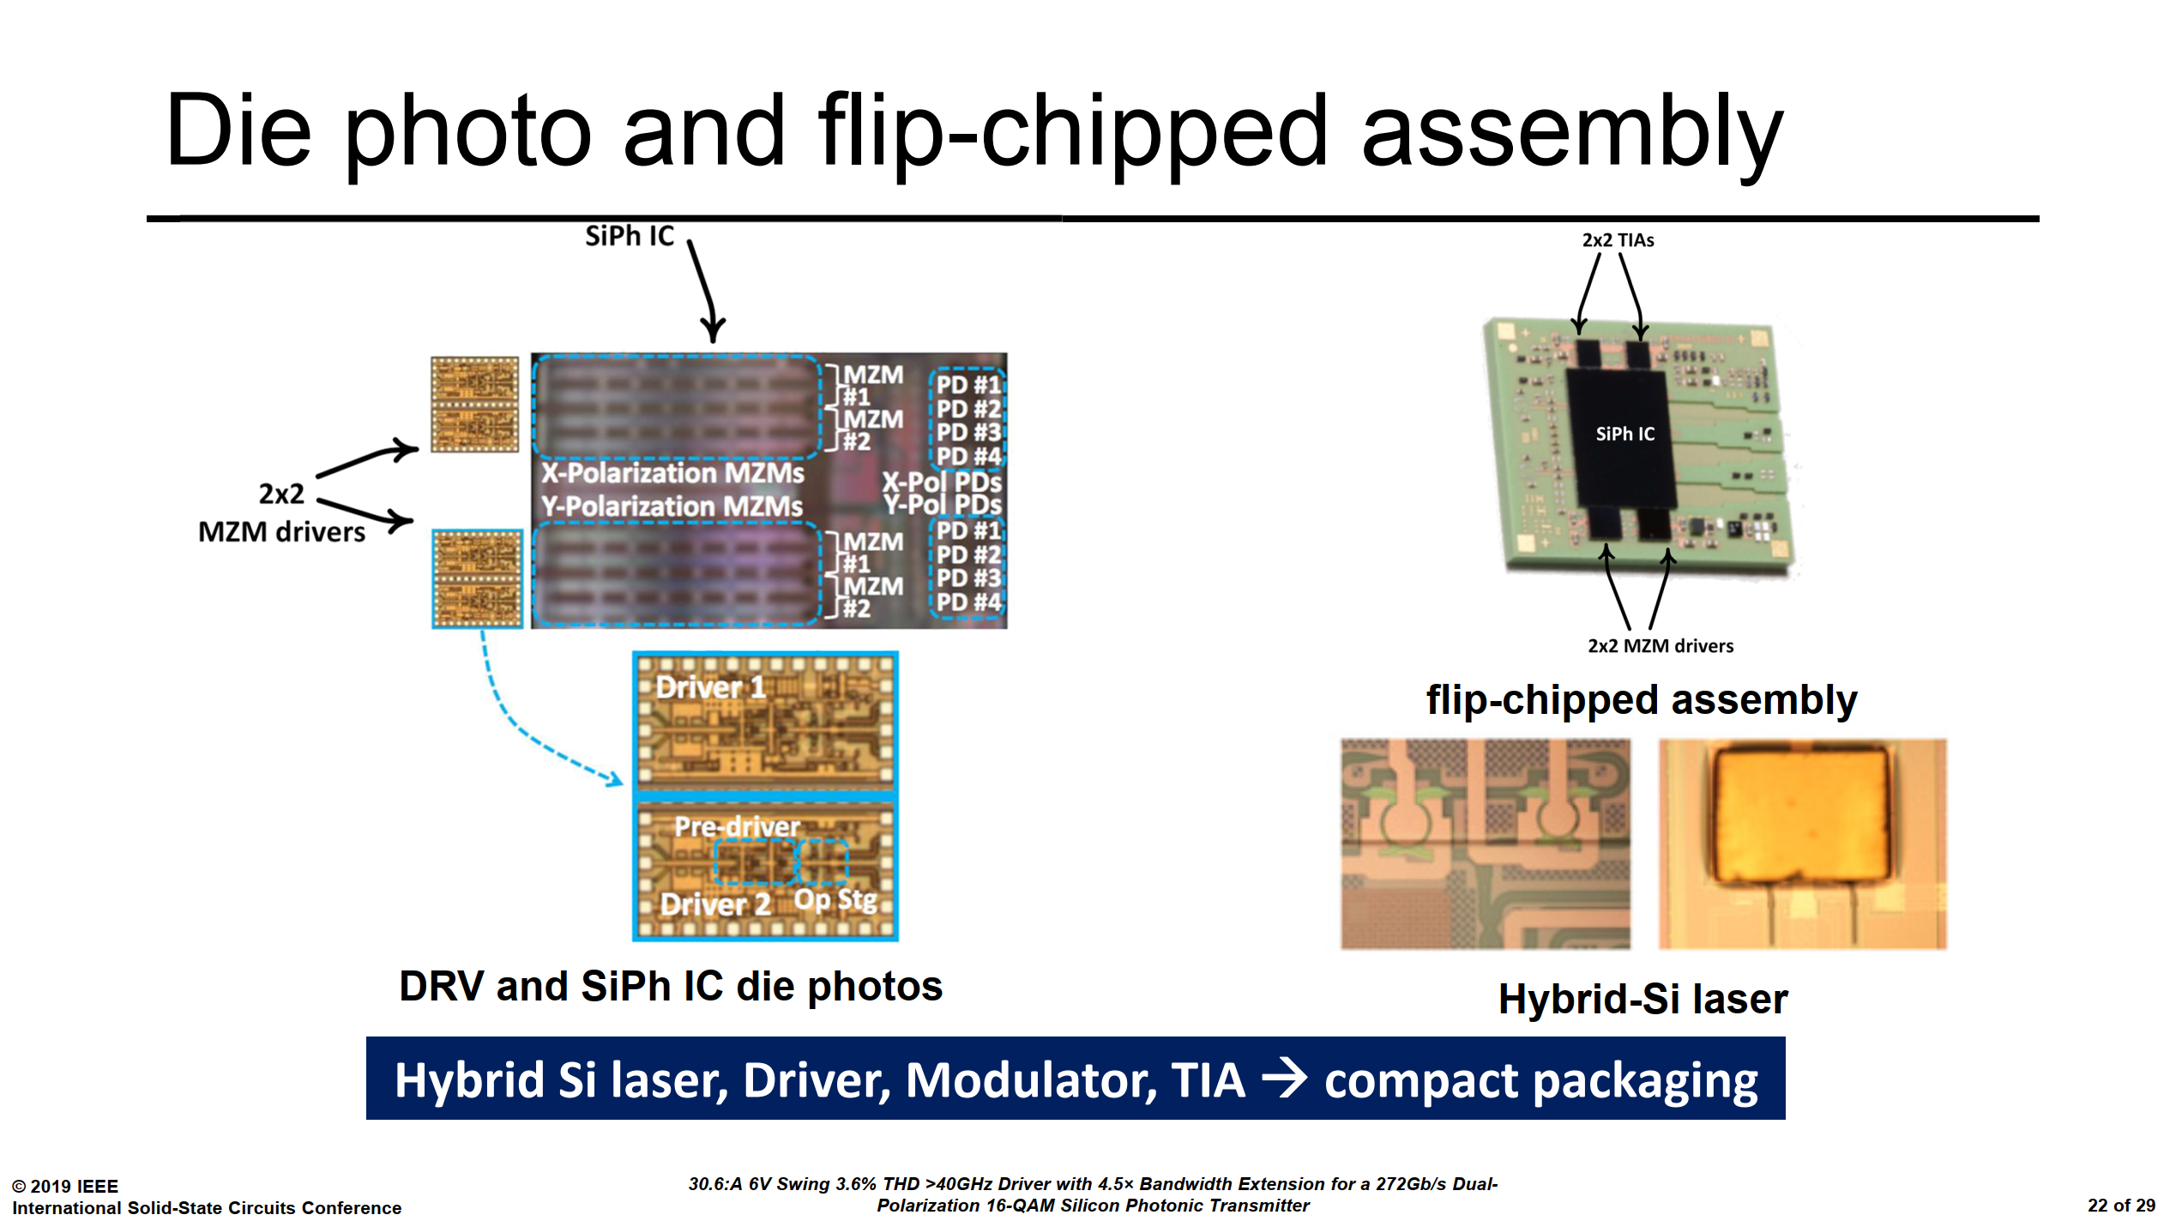
33/41

Slide 35
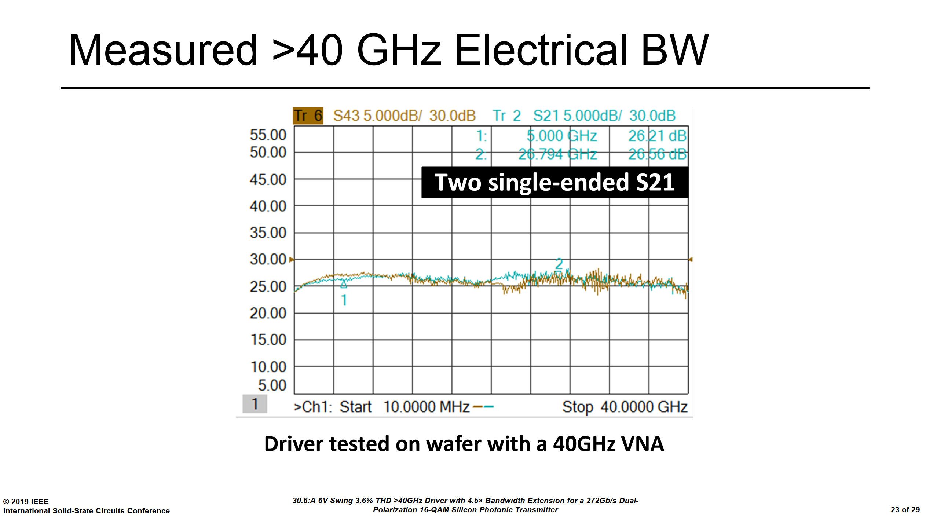
34/41

Slide 36
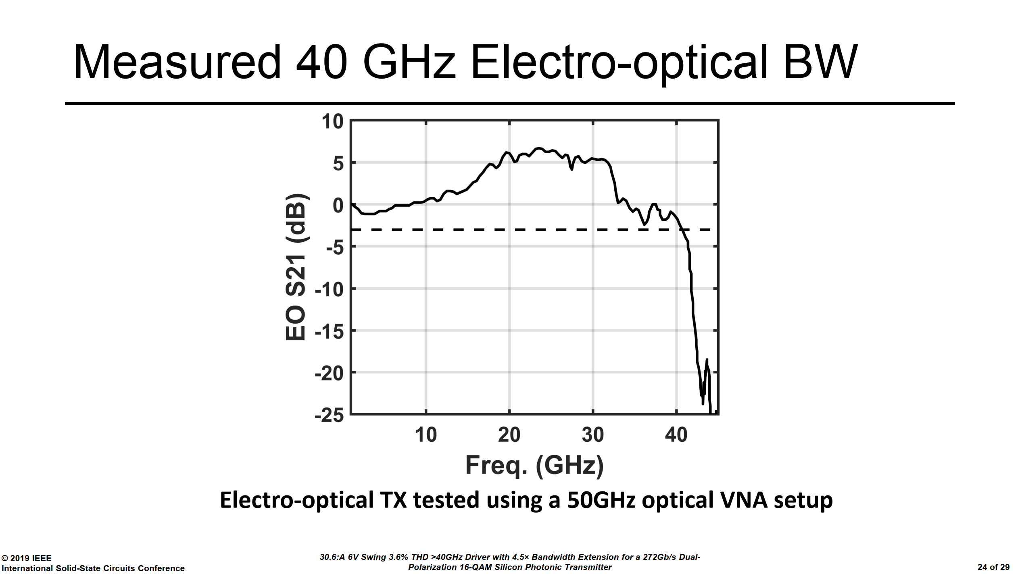
35/41

Slide 37
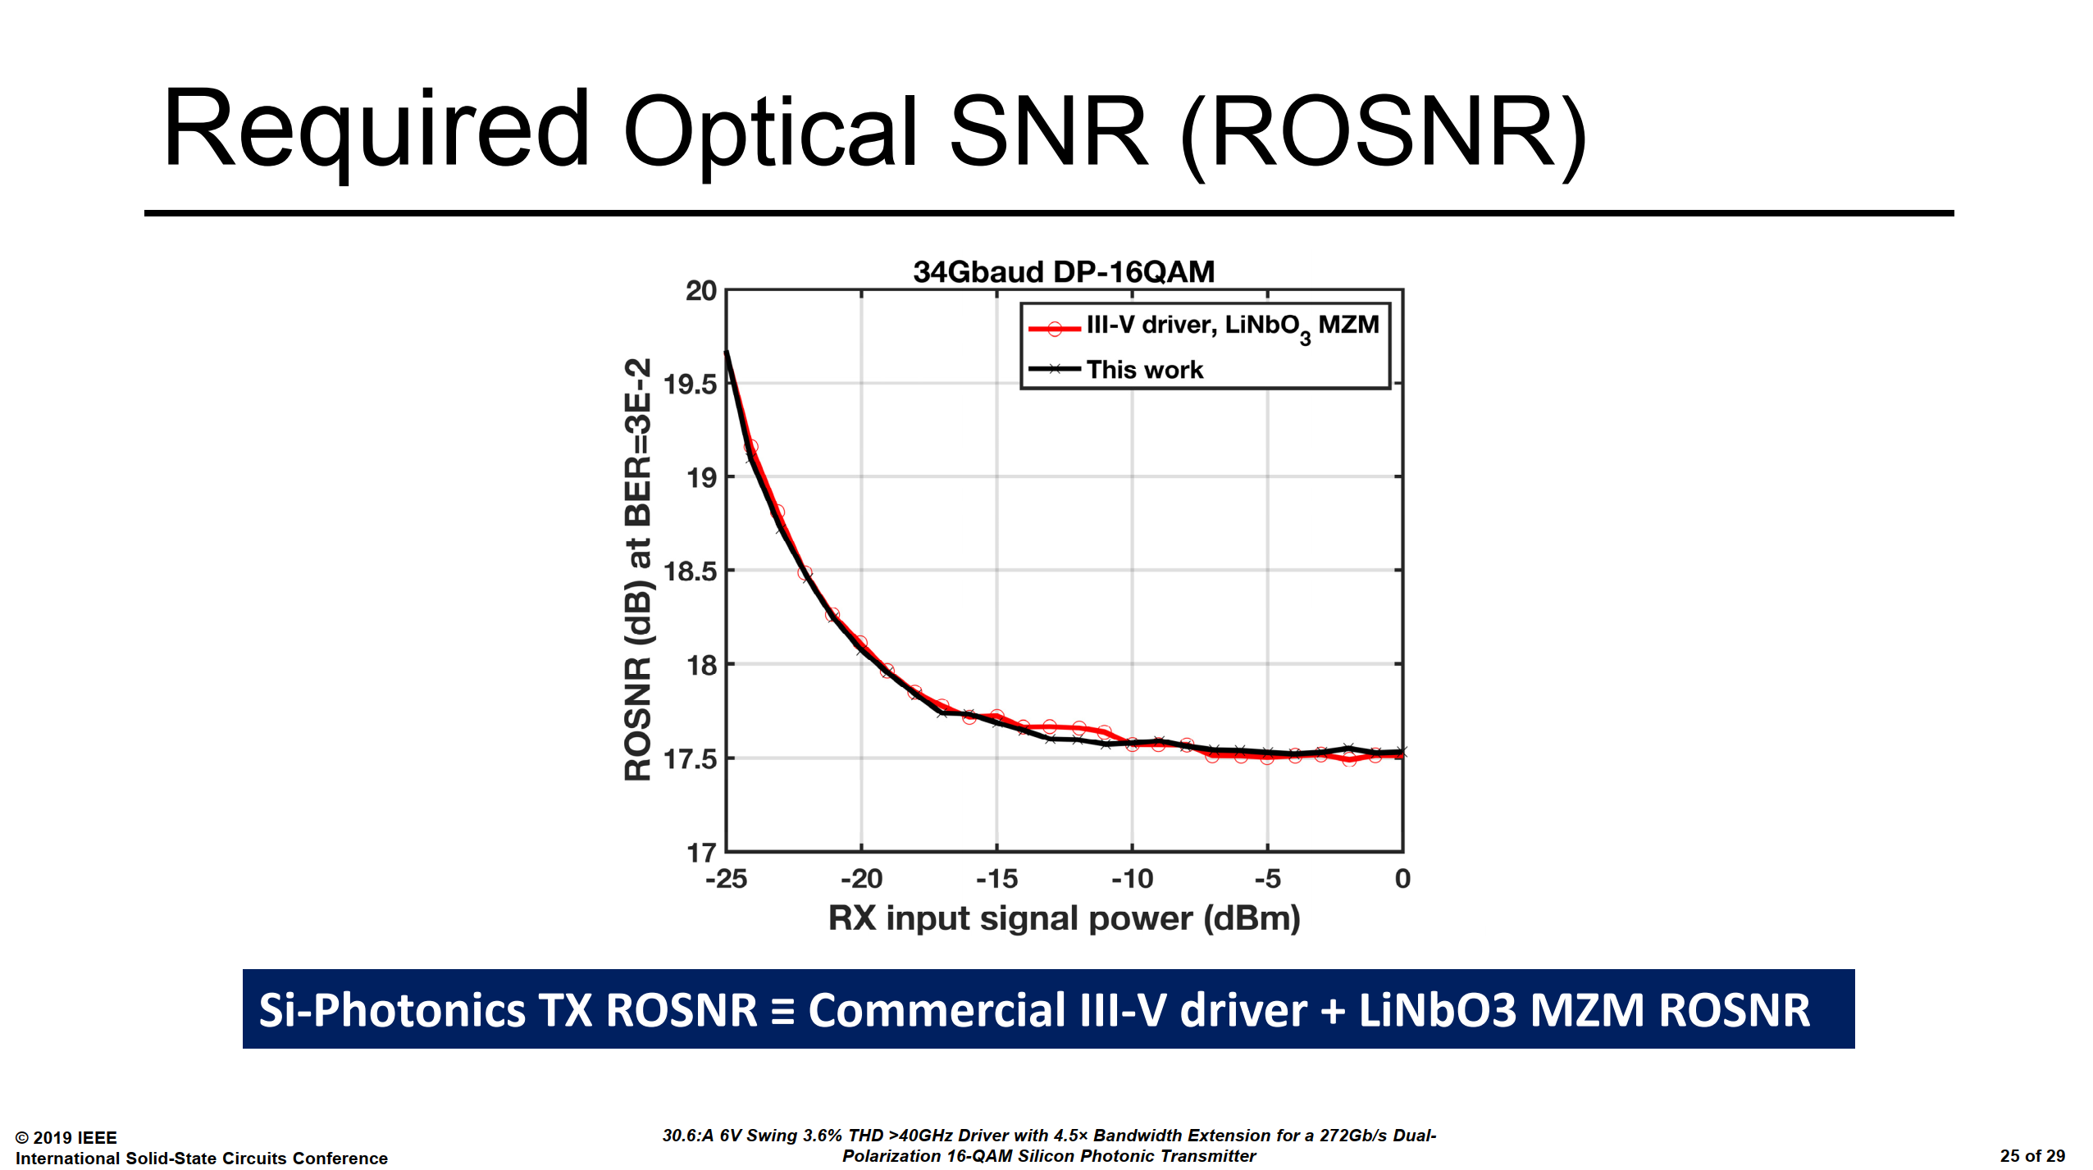
36/41

Slide 38
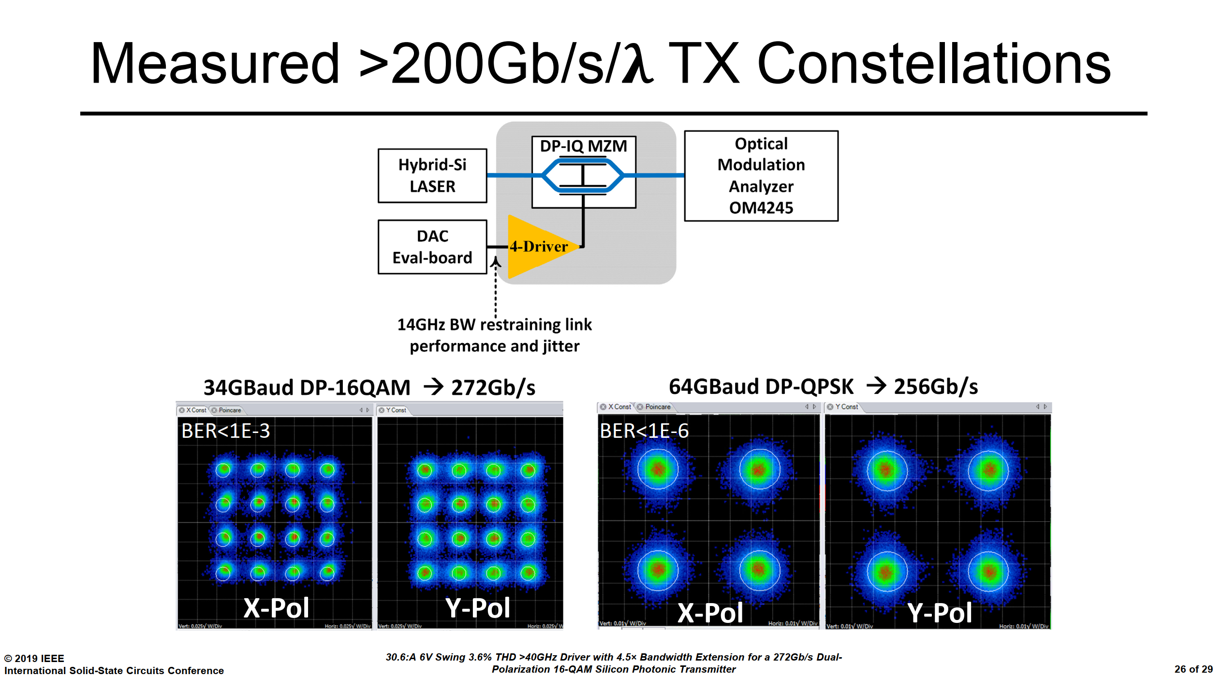
37/41

Slide 39
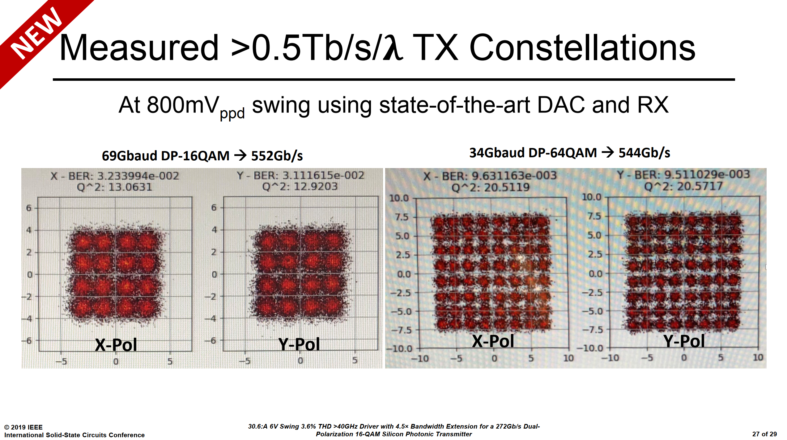
38/41

Slide 40
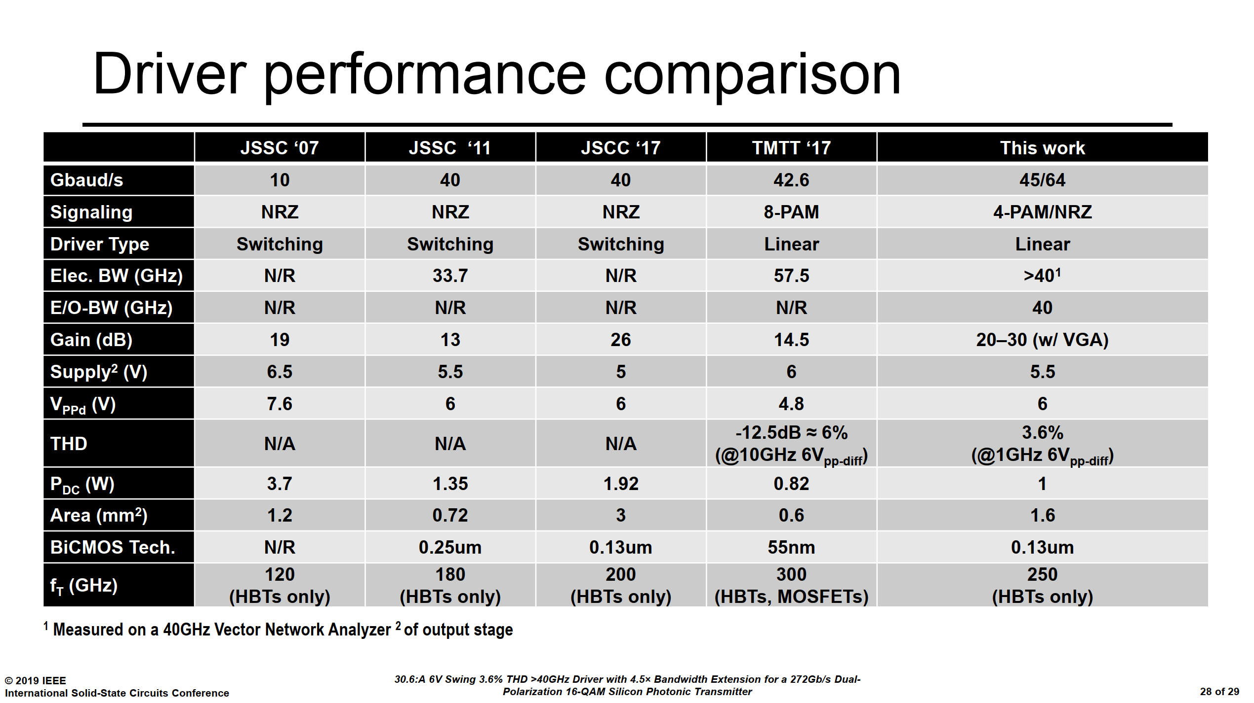
39/41

Slide 41
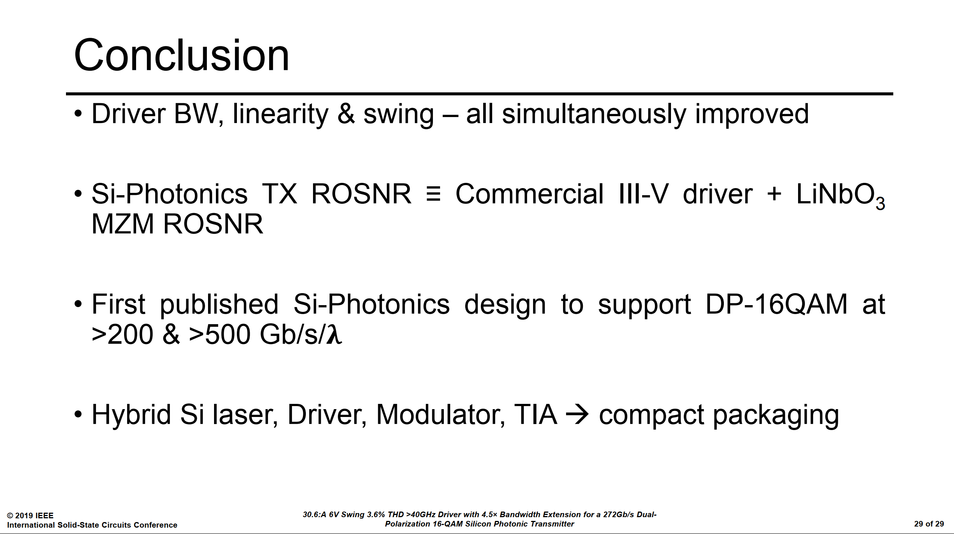
40/41

Slide 42


